Slide 1
Transitions: in the Community and Long-Term Care Presented by: The Dementia Society of Ottawa and Renfrew County

Slide 2
Transitions in the Community
Today we will be exploring the 4 major points of transition in the community and what can help caregivers navigate each:
Diagnosis
Education
Accepting Help
Changes in Environment
Notes:
Learning - building your support network, sharing the diagnosis
Step 1: Diagnosis
Acceptance of the diagnoses, ACP planning, Sharing your diagnosis: Who to tell, how to share
Step 2: Changes in Role:
Who they were before vs who they are now. Caregiver expectations and balancing new emotions: grief, guilt, anger
Step 3: Navigation::
Support groups, social programming, supports in the home through CSS service and private options, referrals
Location: city, rural, distance caregiving, best fits in care
Step 4: Changes in Environment: snow birding/vacations, housing, hospital, (apartment RH, move to LTC. Major life routine changes

Slide 3
Diagnosis

Slide 4
How to Receive a Diagnosis
1. General Practitioner
2. GP can request further assessment and refer to Memory Clinic (either within their family health team or separate clinic) or Geriatric Day Hospital
3. Ottawa: If client has no GP, then they can be referred to Geriatric Assessment Outreach Team (GOAT), who can then refer to a Geriatric Day Hospital.
Renfrew County: If client has no GP, RCVTAC for a referral
If someone has no other avenue, virtual care is an option for a referral

Slide 5
Memory Clinics
Dementia Care Coaches are on site at family health team Memory Clinics along with various hospital Memory Clinics
Dementia Care Coaches offer support in the evaluation, but also offer reassurance to those involved:
Follow up support from the Coach to answer questions throughout their journey
Assistance navigating the diagnosis: loss of a driver’s licence, routine, navigating emotions

Slide 6
Accepting the Diagnosis
How can DSORC help:
Help clients understand the diagnosis
Support around sharing the diagnosis. Who to tell, when to share?
Advanced Care planning
Building a support network
Link families to local CSS
Support Caregivers and Persons Living with Dementia through Education and Resource navigation
Notes:
Families are overwhelmed when they get the diagnosis and have limited time with doctors to as questions.
This is where The Dementia Society of Ottawa and Renfrew County can help!
Dementia Care Coaches are trained to help clients understand and accept the diagnosis.

Slide 7
Education

Slide 8
Learning about Dementia
Education Sessions
Learning is essential to better support someone living with dementia through their changes
Learning could include reading fact sheets, watching videos, attending education sessions or webinars
Support Groups
Caregiver peer support groups provide a safe environment to learn, share, express and help each other through mutual understanding and support
Peer Support/Support Networks can grow when meeting others going through a similar experience
28 virtual support group options per month- Virtually and In-Person
Notes:
Explain the difference between education & SGs and how each can help

Slide 9
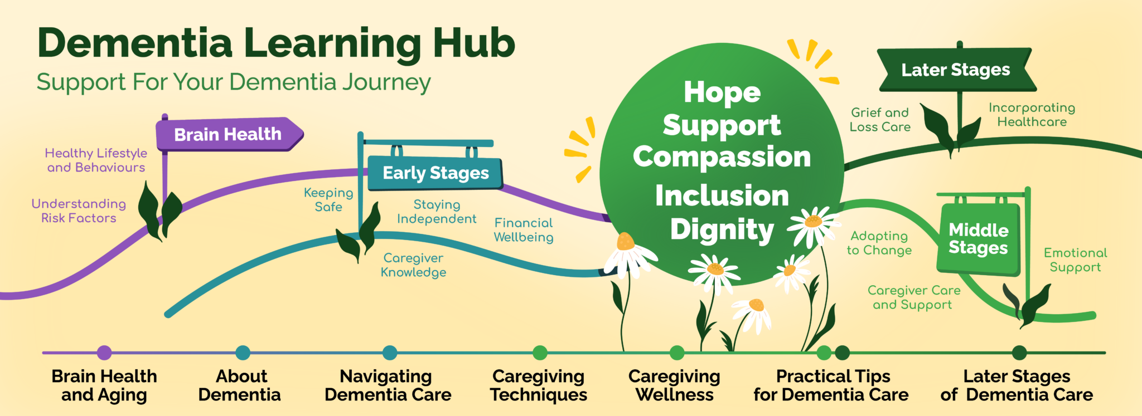
Education at DSORC
Dementia Basics
First Connections
Supporting Dementia
DementiAbility
Advance Care Planning
The Learning Hub
Understanding what dementia is
Learning to adapt and learn new communication techniques
Understanding how to build a support network
Learning to navigate the health care system
Understanding when to introduce care or begin involving community support services
Exploring - what is my role as a caregiver?
Notes:
Dementia Basics: Series of five – information on science of dementia, understanding behaviours and dealing with behaviours. Sessions have been recorded on YouTube and can be watched here.
Supporting Dementia: Session for caregiver of person with dementia. Deals with: progression of dementia, changes in behaviour, strategies to help manage those behaviours;, communication strategies; resiliency. Designed as a workshop so caregivers can use personal examples and share their feelings within the session.
.Dementiability Caregiver Workshop: If you are a family member, friend or caregiver of a person living with dementia, register for this workshop to understand the words, actions and behaviours of your person living with dementia. This detailed education series will help you learn how to address the needs of the person living with dementia and ways to enable and engage your person with dementia to live meaningful lives. This workshop will also help participants think differently about dementia. This workshop is facilitated by a Dementia Care Coach who is certified as a DementiAbility Educator.

Slide 10
First Connections
Education sessions for people newly diagnosed with dementia to attend with their care partner (if they wish).
Topics Covered:
What is Dementia?
Diagnosis and Types
Impacts of Dementia communication
How to manage feelings and cope
Resources in the community
Advanced Care Planning introduction

Slide 11
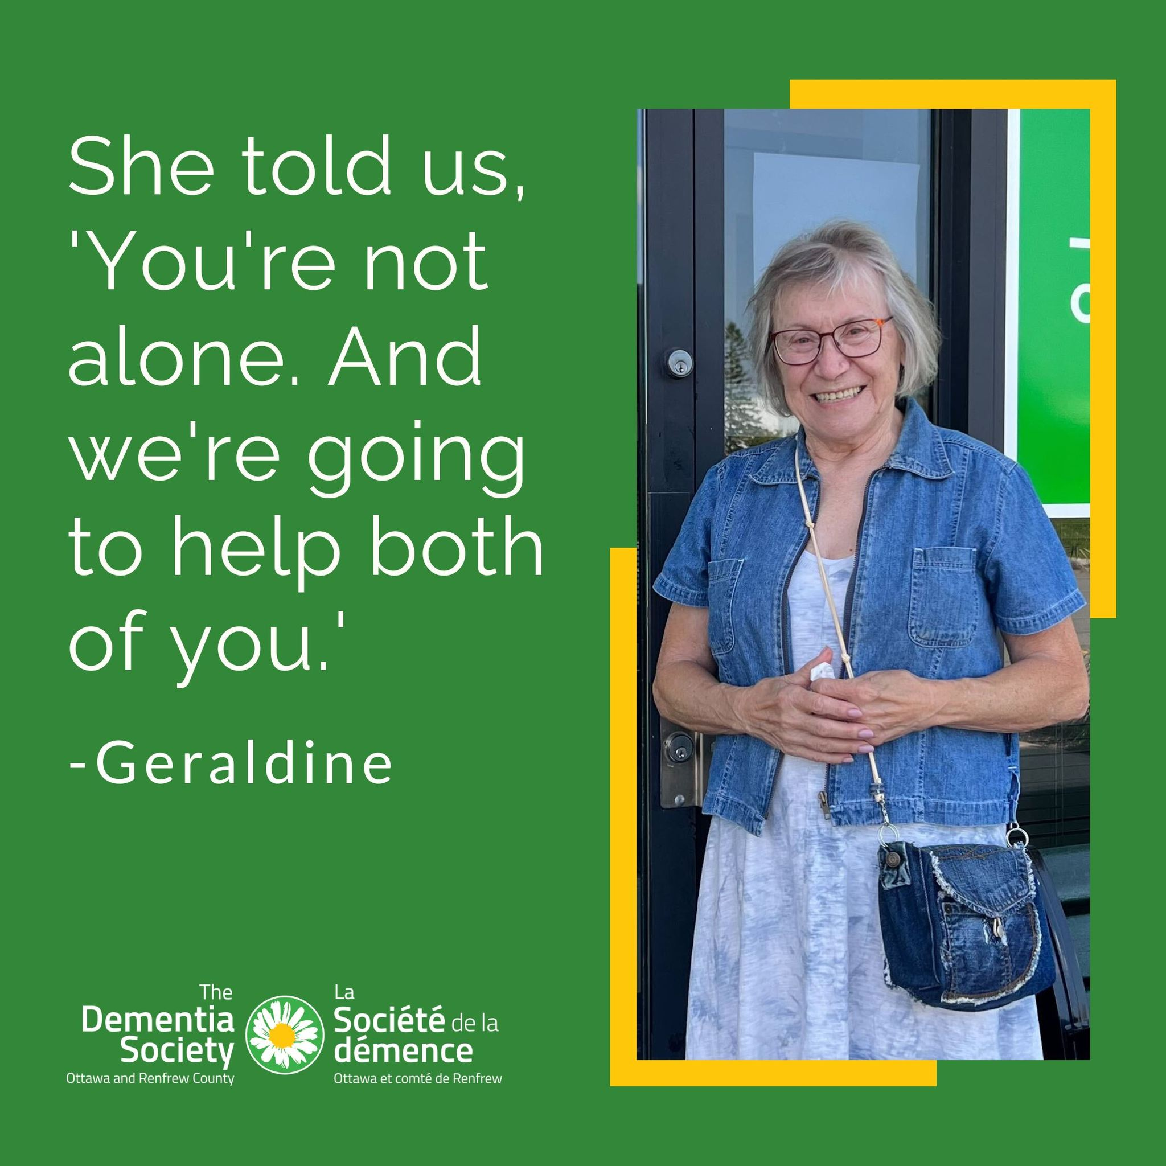
Dementia Care Coaches
Educating on dementia progression
Strategies and tips around behaviours
Connecting to peer support groups
Coaching on communicating with their loved one differently
Connecting to community resources
Help with transitioning to a new home
We provide these services via telephone, conference calls, or Zoom video.

Slide 12
Advance Care Planning Resources
Support in understanding what Advance Care Planning is.
Some helpful resources:
Speak up Ontario Click Here for Workbook
Advanced Care Planning Guide: Click here
Make a Power of Attorney Click here
Champlain Dementia Network List of Resources: Click here

Slide 13
Practical Tips and Strategies
One Example of a topic covered in education and coaching:
Changes in Eating
How to encourage eating and remain independent
How to provide an inviting environment
When to introduce new tools or adaptive devices
Tips for eating at restaurants
By Us For Us Guides | Research Institute for Aging

Slide 14
Accepting Help: Navigation - Where do we direct people?

Slide 15
Why is introducing help so hard?
Ambiguous Loss
Inviting strangers into the home
Accepting things are changing
Denial/Lack of Insight from the person living with dementia
Grief & Guilt

Slide 16
A few words about Guilt
It is normal to experience feelings of guilt during caregiving.
These feelings may be triggered by:
thinking that you could be a better caregiver;
thinking that you should not take any breaks for yourself;
feeling angry and frustrated with the one you are caring for; or
thinking about placement in a residential care home.
If you do experience feelings of guilt, you need to say to yourself:
I am doing the best I can.
There are some things I cannot control.

Slide 17
Community Support Services
Adult Day Programs & Respite
Care Coordination & Navigation
Caregiver Support
Condition Specific Supports
Food & Meal Programs
Foot Care Services
Home Help & Home Maintenance
Health Promotion & Education
Palliative Care
Recreation, Fitness &
Social Activities
Safety & Security Programs
Support & Care at Home
Transportation
Notes:
Adult Day Programs and Respite: Adult Day Programs, in –home respite and overnight stay care
Care coordination and Navigation: Coordinated Access/Central intake function to take the guesswork out referrals to CSS
Caregiver Support: Individual and group support, caregiver training and education, and grief and bereavement support
Condition Specific Supports: Acquired Brain Injury, Alzheimer’s/Dementia, Aphasia and speech and language supports, palliative care, stroke supports, vison and hearing loss supports.
Food and Meal Programs: Meals on Wheels, specialized meal programs, group dinning, shopping assistance and delivery and grocery bus
Foot Care: Specially trained foot care nurses provide hands-on foot care including: Assessment Clipping & filing of toe nails Treatment of corns, calluses, ingrown nails, thickened nails Padding as necessary Preventative foot care for high risk clients with diabetes, arthritis and circulation problems
Home Help & Home Maintenance: subsidized and nonsubsidized services for cleaning, maintenance, and meal prep
Health Promotion and Education:
Palliative Care: Visiting, residential hospice, hospice day programs, assistive devices and equipment and grief and bereavement support
Recreation Fitness and Social Activities: Group dinning, fitness and exercise programs and recreational and social programs
Safety and Security Programs: Telephone safety Checks and Friendly Visiting volunteers
Support and Care at Home: Attendant Care, Assisted living services, personal support services, Respite and supportive housing
Transportation Services: transportation to medical appointments and essential services and the grocery bus program

Slide 18
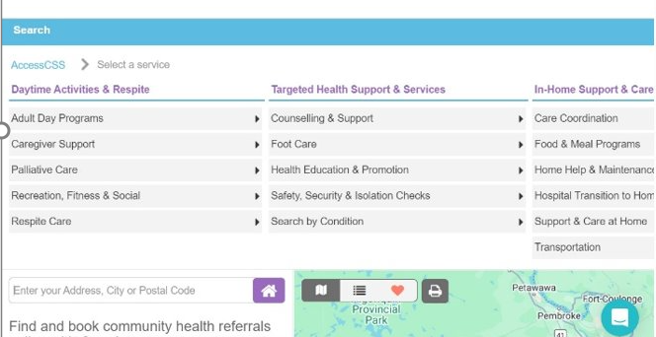
Caredove- Referral Platform for Community Support Services
What is Caredove?
A referral management platform designed to simplify the process of connecting people with community services.
Enables seamless communication between healthcare providers, social services, and clients.

Slide 19
One public facing website focused on providing access to CSS services to the public, partners and Health Care Providers in Ottawa
provides access to Community Support Services across OHE through Caredove e-referral (public search and clinician search)
Link: Health Care Navigation Services | AccessCSS

Slide 20
Seniors Needs Assessment
Fill out the Seniors Needs Assessment to connect with healthy aging services in the Ottawa Valley area that can support your needs or the needs of someone for whom you are caring.
Seniors' Needs Assessment

Slide 21
Ontario Health at Home
Ontario Health at Home is an initiative that allows eligible individuals to receive healthcare services in the comfort of their own homes.
The program aims to provide personalized care, such as nursing, therapy, and medical support, to individuals who are recovering from illness or managing chronic conditions.
This service is designed to enhance patient outcomes and improve convenience by reducing hospital visits, promoting independence, and offering more flexible care options. It is supported by Ontario Health and connects patients with healthcare providers and resources to ensure comprehensive, coordinated care.
OHatHome also assists those with exploring long-term care (LTC) options, day programs & more.
Click here: Ontario Health atHome

Slide 22
Geriatric Psychiatry Community Services of Ottawa (GPCSO)
Mission: Provide expertise & leadership in the practice of community-based geriatric psychiatry while using an interdisciplinary approach with the aim of enhancing the mental health & well-being of the elderly
Services are:
Support & resources are offered to families of the impact of dementia
Specialized support for PWD’s presenting with difficult behaviours
Services provided to seniors 65 and over who have mental health problems
Families helped to understand & cope with challenges
Visits include home or retirement home to support with training
Referrals are made by physicians Click here: GPCSO

Slide 23
Geriatric Mental Health Services of Renfrew County
Provides:
Comprehensive assessments for persons over the age of 65 years of age experiencing mental health problems
Follow up visits provided as required
Education / training for professionals / families on geriatric psychiatry topics
Pembroke - Geriatric Mental Health

Slide 24
Crisis Support
Crisis Line/Distress Centre: Click here
Crisis Support:
Ottawa: Click here
Renfrew County: Click here
Elder Abuse Program
Ottawa: Click here
Renfrew County: Click here
Counselling Services
AccessMHA: Click here
911

Slide 25
Private In-Home Support Agencies
DSORC can help clients understand the private service industry
This may include services such as
Personal Support Services
bathing, dressing, grooming toileting etc
Housekeeping
Companionship
Use this tool to search for a private support agency:
Home Care Services - Home Care Ontario

Slide 26
Social Programs at DSORC
Introduction to CSS services in the early stages
Creating a positive experience through a short activity-based programs
Showing caregivers the value of small amounts of respite
Run by Dementia Care Coaches and volunteers
Daisy Café & Café Marguerite
Musical Programs
Creative Art & Crafting Programs
Choirs
Spark! Rayon D’ART
Click here for our monthly calendar of programs

Slide 27
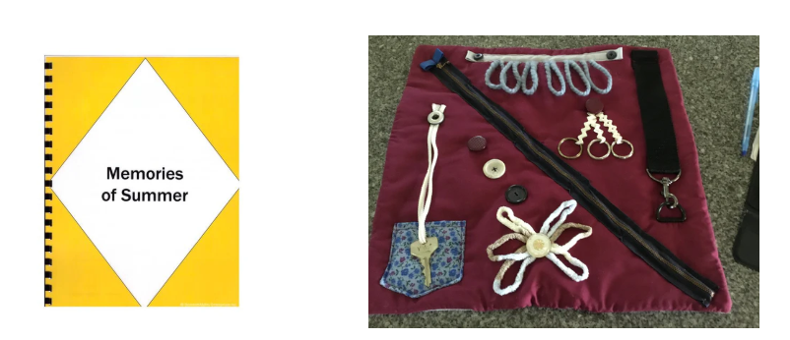
Lending Library & Showcase Room
Check out our assortment of activity packages, companion animals, dolls, technology and other items available to loan for free. Click here

Slide 28
Changes in Environment

Slide 29
Navigating transitional changes
Respite Care
Helping caregivers identify when this is the right time
Identifying options
Hospital Stays
Often very stressful
Change in routine and possibly baseline health
May result in a change in home status
Retirement Home or LTC
When home is no longer an option
Finding the right home
How to prepare for the move
Learning to work with staff as a new part of the care team
Helping PLWD adjust to a new routine
Notes:
Using All About Me Booklets or posters to help with these transitions

Slide 30
CSS Advisor in the Emergency Department
CSS Advisor Pilot Project
The CSS Advisor helps to relieve pressures in the hospital emergency department by improving access to care available in the community. The CSS Advisor is imbedded into TOH (Civic) Emergency department. The CSS Advisor serves as a resource to patients, caregivers, and health care professionals to facilitate knowledge transfer about community support services. The CSS Advisor is referred to patients aged 55+ who may require support in their home.
55+

Slide 31
Moving is not easy
Relocation is a major stressor,
May not recognize when it's time to move.
Both familiar and unfamiliar settings may become more challenging.
The feeling of losing control often leads to defensiveness and resistance to moving suggestions.
Notes:
Lord, K., Livingston, G., Robertson, S., & Cooper, C. (2016). How people with dementia and their families decide about moving to a care home and support their needs: development of a decision aid, a qualitative study. BMC geriatrics, 16(1), 68.
The decision to move is often difficult and stressful, especially as the person with dementia and their family may have never thought that they would live in a care home and there may be disagreement about the need to do so coupled with concerns that the person with dementia may never learn to navigate their new surroundings.

Slide 32
Getting Ready for Care: Do what you can, when you can do it
The transition to long-term care can be improved by knowing your loved one’s preferences e.g.:
Having a good knowledge of your loved one’s medical history
Understand their preferences with advanced directives. Example: Coffee then shower, or shower then coffee: Knowing their routines, likes and dislikes
Notes:
Advanced Care Planning conversation, and creating a personalized Care Plan for LTC staff.
Pain management strategies (medications and therapies)
Preferences for daily activities and routines
Involvement of Palliative Care team
Update and review the plan regularly based on changing needs.
Legal and Ethical issues: advance directives, POA, DNR orders
Modifications for safety and comfort
Discussing end-of-life considerations: hospice care and final wishes

Slide 33
Modules for Long-Term Care Transition
These modules can assist caregivers in understanding the key aspects involved in transitioning to Long-Term Care when such a move becomes necessary.
Preparing for the Move
Moving Day
Adjusting

Slide 34
Suggestions when Transitioning

Slide 35
Emotions
Sadness and Grief- Recognizing that dementia is a terminal illness can evoke profound sadness. Anticipatory grief may arise as you mourn the loss of the person your loved one once was.
Fear and Anxiety – Fears about the dying process, uncertainty about what to expect, and concerns about making the right decisions can create significant anxiety.
Guilt and Regret – Caregivers may grapple with feeling so guilt, questioning if they are doing enough or making the right choices regarding treatment and comfort.
Relief – For some, transitioning to palliative care can bring a sense of relief, particularly if it alleviates the stress of aggressive treatments and focuses on comfort.
Connection and Love – This transition may also deepen feelings of connection and love, as caregivers spend meaningful time with their loved ones, focusing on their needs and preferences.

Slide 36
A Quick Look at How we Help...

Slide 37
Questions?
Contact Us:
https://dementiahelp.ca/
Call: (613) 523-4004 Toll Free: (888) 411-2067 Fax: (613)523-8522 Email: info@dsorc.org
Support Hours:
Monday – Friday: 8:30 AM – 5:30 PM

