Slide 1
Bringing it all together
Jennifer Cavanagh OT Reg (Ont.),
Clinical Manager, Geriatric Psychiatry Community Services of Ottawa
Melissa Ngo (she/her)
MDes, Implementation Lead, Ontario Caregiver Organization
2025 – Supporting Dementia Care Partners: Everyone is a Change Agent
Notes:
Hi everyone, good afternoon. Welcome to your last session of the day! Jennifer and I are here today to close out what we hope to be a meaningful and learning-filled event for you all. My name is Melissa and I'm from the Ontario Caregiver Organization. Jennifer is from the Geriatric Psychiatry Community Services of Ottawa. I'll let her introduce herself. I’ll be talking to you today about Ontario Caregiver Organization’s work on Essential Care Partner Programs. I’m one of the Implementation Leads on the Essential Care Partner Support Hub Team, which just means that I support organizations while they are planning to create, develop or enhance their new or existing caregiver initiatives. I’m very happy to be presenting today on who we are, the components of an effective Essential Care Partner Program, and how this relates to all of us here in the room.

Slide 2
Agenda
About OCO and involving caregivers as partners
The landscape of caring
How we can help: Ontario Caregiver Organization’s Essential Care Partner Support Hub
Resources
Reflections and Actions
What next?
2025 – Supporting Dementia Care Partners: Everyone is a Change Agent

Slide 3
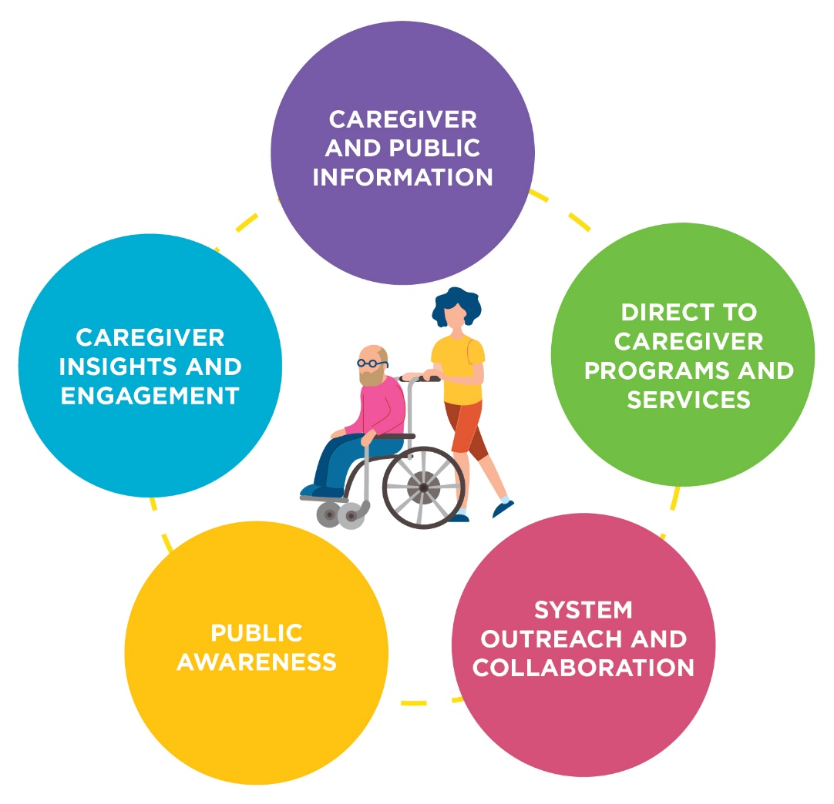
About the Ontario Caregiver Organization
The Ontario Caregiver Organization (OCO) exists to improve the lives of Ontario caregivers; ordinary people who provide physical and emotional support to a family member, partner, friend or neighbor.
2025 – Supporting Dementia Care Partners: Everyone is a Change Agent
Notes:
OCO exists to improve the lives of Ontario caregivers regardless of age, diagnosis of the care recipient or where they live. Founded in 2019, we are a not-for-profit organization.
This diagram shows how the OCO works to improve the lives of caregivers, who are at the centre of everything we do. These are the five areas that we support: Caregiver and Public Information, Direct to Caregiver Programs and Services, System Outreach and Collaboration, Public Awareness, and Caregiver Insights and Engagement. I'll touch a little bit on each of these sections with a focus on system collaboration and caregiver programs.
But first, let’s take a quick look at the caregiving landscape in our province.

Slide 4
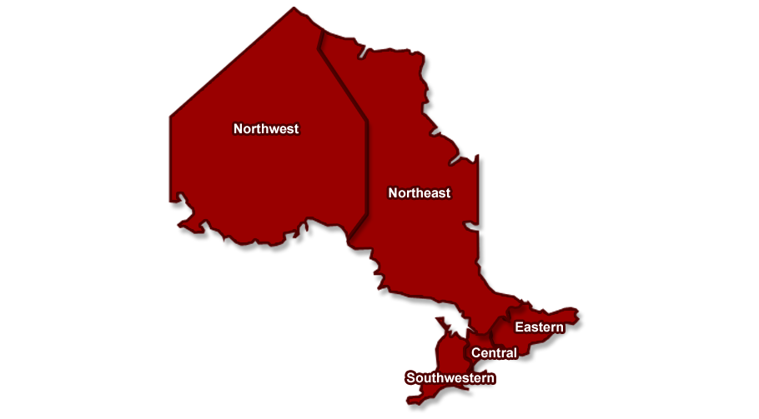


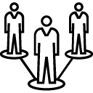

Ontario Caregivers: At a Glance
4 million across Ontario, including young caregivers
From every age group:
16-25 years – 14%
26-45 years – 35%
46-65 years – 36%
65+ years – 15%
Gender:
Women – 52%
Men – 46%
Non-binary – 2%
67%
are employed
Notes:
When we talk about why we do our work, studies estimate caregivers provide 75% of the care in the healthcare system. There are approximately 4 million caregivers in Ontario caring for a family member, partner, friend or neighbour. They can be people caring for aging parents, a spouse caring for their partner, or young caregivers like siblings.
This is a quick snapshot of the caregiver profile in Ontario, taken from the OCO’s 2024 Spotlight Report.
I mentioned 4 million caregivers across the province, and they are across all ages and genders. There is an overwhelming number of caregivers – 67% - who are also in the workforce. That might be some of you in this room today.

Slide 5
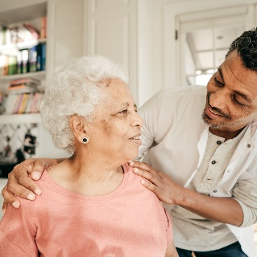
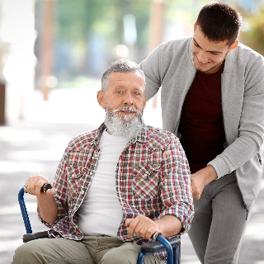
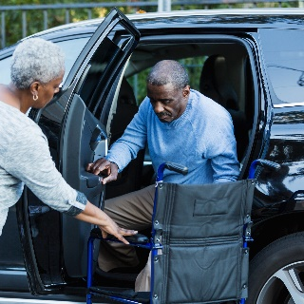
Who are they? Do you know a caregiver?
84%
care for one person, usually an older family member, often a parent. A third of caregivers are new to the role over the last two years.
51%
of caregivers are part of the “sandwich generation”, caring for their own parent(s) or in-laws while also raising children under the age of 18.
49%
of care recipient live with the caregiver, while 37% live in other private homes, 12% live in healthcare facilities.
2025 – Supporting Dementia Care Partners: Everyone is a Change Agent
Notes:
Caregivers are in a varied and diverse spectrum of scenarios and situations that make each of them unique. It might be the number of people they look after; their relationship to the care recipient; the location in which the care is provided, how their culture or family makeup looks like – and they may have intersectional identities. Something to reflect on, is that I’m sure we all know someone who is a caregiver, and that we all have the potential to become a caregiver one day, if we’re not one already.

Slide 6
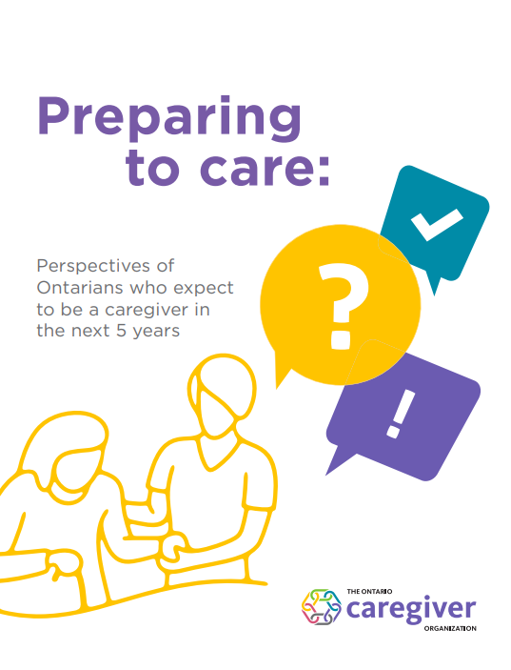
Preparing to Care Report
Over the next 5 years, the number of Ontarians providing physical or emotional support to a family member, partner, friend, or neighbour could increase by more than 50% - from 4 to 6.5 million people.
That is 2.5 million more caregivers by 2030.
Notes:
We just released our Preparing to Care report – with a few staggering numbers. There can be 2.5 million more caregivers in Ontario by 2030. As health and social care systems plan for the increasing capacity demands as the population ages, it needs to be understood that family caregivers are in dire need of support. In our report, it notes that seventy-five per cent of current caregivers feel so burned out they worry about whether they will be able to continue in the role. OCO sees this as a need to provide prospective caregivers with information and planning tools ahead of time, that enable them to feel confident, for when they do find themselves in the caregiving role. By supporting Ontarians in the planning process, we hope to reach people long before they are taking on caregiving responsibilities or their health and wellness is compromised. Because, we also know that when caregivers are healthy, patients are healthy. We work with healthcare leaders, educators, and system partners in the adoption of caregiver-friendly practices that have shown to make a difference in the lives of caregivers and ultimately, their loved ones as well.

Slide 7





The Impact of Caregiving
Time
Employment and Work-Life Balance
Finances
Health and Wellness: Mental, Emotional, Physical and Social
Personal Relationships
2025 – Supporting Dementia Care Partners: Everyone is a Change Agent
Notes:
In this room, we are all deeply aware that the impact of caregiving can be significant – you all do this every day as frontline workers and healthcare staff doing caregiving work - and I'm sure have been impacted in many ways yourselves. Caregivers have told us, that caregiving has an impact on time, their jobs, finances, their own physical and mental health and the relationships they have with others, amongst other factors. Caregivers may enter the healthcare system themselves because of the amount of mental and physical energy they are spending that can affect their physical health. And that is on top of other systemic barriers they may face on a day to day.

Slide 8

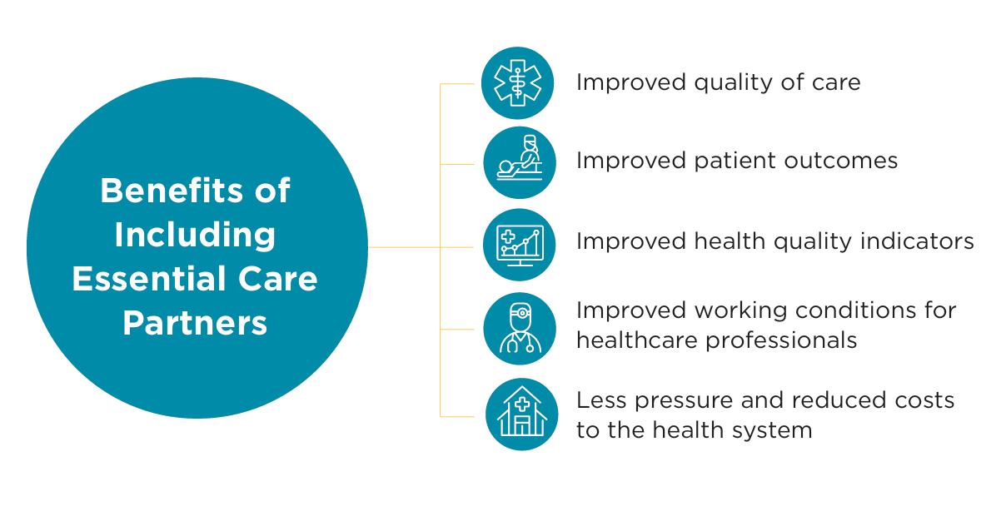
What are some benefits you can think of, when you include caregivers in your practice?
February 2025 – Essential Care Partner Support Hub
2025 – Supporting Dementia Care Partners: Everyone is a Change Agent
Notes:
Let’s now talk about the impacts of caregivers on our healthcare system. I'm going to ask the audience to think about this for a moment. I encourage you to put your hand up and share, what are the benefits you can think of, when you include caregivers in your practice?

Slide 9
2025 – Supporting Dementia Care Partners: Everyone is a Change Agent
Notes:
As I mentioned before, when caregivers are equipped, supported and healthy, it means patients are equipped, supported and healthy. When we incorporate our three pillars of Identify, Include and Support in Essential Care Partner Programs, health outcomes and quality of care are improved for patients. This can mean:
Adherence to and positive responses to medical instructions
Medication adherence
Opportunities for preventative care
Language or cultural understanding
Help to lessen the load on frontline workers
Understanding of discharge instructions and continuum of care after discharge
When we include caregivers, there are reduced costs to the healthcare system
If you’re thinking you’d like to be involved and/or advocate for additional supports, please connect with me afterward, and I’d be happy to work alongside you to bring more caregiver presence into your programs and services.

Slide 10
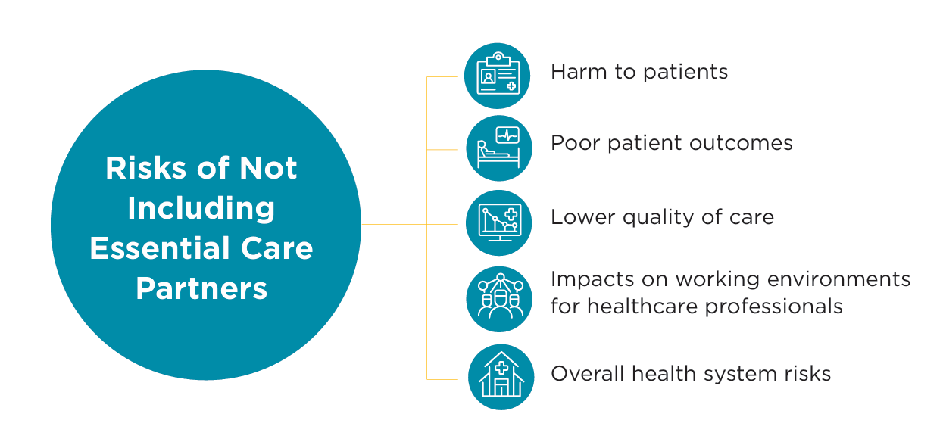
What are some risks you can think of, when we do not include caregivers in our practice?
2025 – Supporting Dementia Care Partners: Everyone is a Change Agent
Notes:
I'm going to ask the audience to think about this for a moment. I encourage you to put your hand up and share, what are the risks you can think of, when we do not include caregivers in our practice?

Slide 11
2025 – Supporting Dementia Care Partners: Everyone is a Change Agent
Notes:
If we’re not including an Essential Care Partner, or caregiver, in a patient’s care, here are some risks that might arise.
Patient’s cognitive, mental and physical health can decline
Increased risk of depression
Increased risk of falls
Missed opportunities for patient history
Missed opportunities for preventative care
Greater risk for those with linguistic/ethno-cultural care needs or complex conditions
Risk to culturally-safe care
Increased hospital usage:
Less successful transitions and risk of readmission
Increased demands on health care workers

Slide 12
Everyone is a change agent
How can caregivers help you, and how can you help caregivers?
Changing our practice can involve setting small goals​
Small goals by many people leads to a big change
2025 – Supporting Dementia Care Partners: Everyone is a Change Agent
Notes:
This circles back to the very name of this conference – everyone is a change agent. Caregivers and service providers are on the same side, and when our care partners – which can all include healthcare staff and caregivers – are healthy, this means, our patients are healthy. Caregivers and care providers like yourselves have a lot in common and often have the same goals. And the overall message today is that you can make a small change that can result in a big ripple. When we think about the 4 million existing caregivers, the 2.5 million more who are to come in 5 years, and the benefits of us working together as a team, plus the risk of us not working together – the patient, caregiver and healthcare provider – it is obvious that we need to make change happen together by working together and supporting each other.

Slide 13
Essential Care Partner Programs
2025 – Supporting Dementia Care Partners: Everyone is a Change Agent
Notes:
This brings me to this next section, where I can share some information about our Essential Care Partner Program and a little more about what I do day-to-day. As I mentioned earlier, my primary role is to help embed caregiver support into healthcare organizations. More specifically, I support healthcare spaces that are embedding Essential Care Partner Programs into their sites.

Slide 14
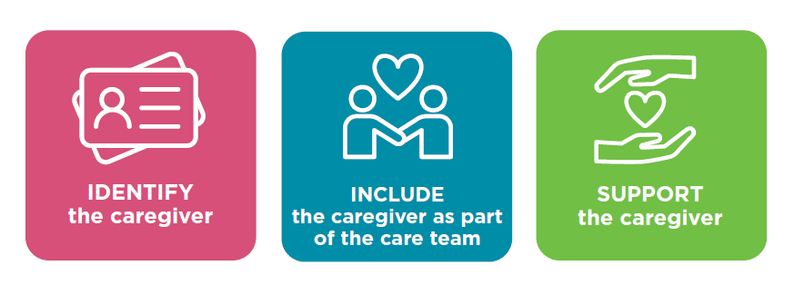
What is an Essential Care Partner Program?
Policies and practices implemented in a care setting that identify, include and support caregivers as essential partners on the care team
2025 – Supporting Dementia Care Partners: Everyone is a Change Agent
Notes:
You might be wondering, what is an Essential Care Partner Program?
An Essential Care Partner Program may look different to different healthcare sites. At the baseline, it is simply involving the caregiver in the care journey of a patient, resident or client. You can look at it like formalizing the caregiver role as a partner in care, and respecting that their role is valid and important when it comes to patient care. You might wonder why I’m sharing this information – its because frontline staff have been massive champions of essential care partner programs historically. Frontline staff have been the reason why there was an Essential Care Partner Program developed and embedded into their hospital system, because of their persistent and effective advocacy for their patients and families. So, just in case you want to help build on this culture of caregiver support at your site, I’m going to share this information to let you know that OCO can help you advocate for this!
Our work with care providers always has 3 important pillars: IDENTIFY, INCLUDE and SUPPORT.
Identifying and recognizing caregivers in their important role
Including caregivers as true and genuine partners in the healthcare team so that they can participate in care
Support caregivers in well-being, so that they are feeling equipped to do caregiving work, and hopefully, lessen the risk of burnout or their own healthcare challenges while they take on this role
Lets dive more into these three components.

Slide 15
What do you do to help Identify, Include and Support caregivers in your everyday work?
2025 – Supporting Dementia Care Partners: Everyone is a Change Agent
Notes:
I’m going to ask you to reflect on this question as I go through the next few slides. What do you to do help identify, include and support caregivers in your every day work? And perhaps, what can you do to support caregivers in your everyday work?

Slide 16
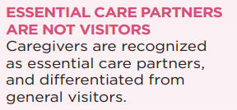
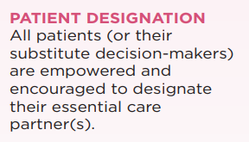
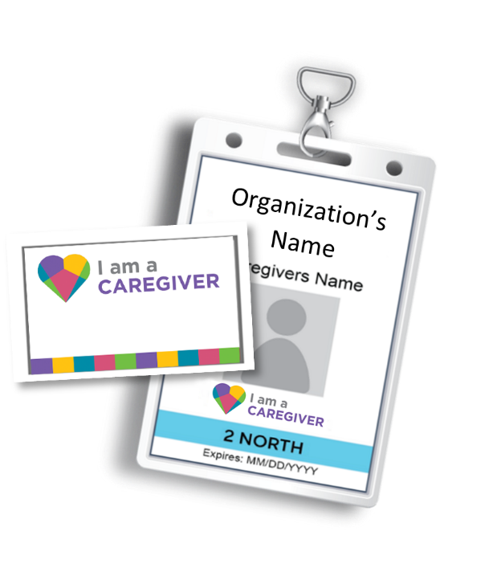
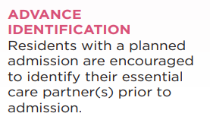
Identified by the patient or resident
Necessary for safety, quality of care, health outcomes and well-being
2025 – Supporting Dementia Care Partners: Everyone is a Change Agent
Notes:
The first is to identify the caregiver – at OCO, we have Caregiver ID templates, scripting for introducing caregiver badges or identification, and project planning templates for roll out of ID badges. Identification is important because caregivers don’t always recognize that they are caregivers and that they have some important pieces of information to share when it comes to patient care. So for that reason, we also have resources to help caregivers recognize that they are an important part of their loved one’s care.

Slide 17
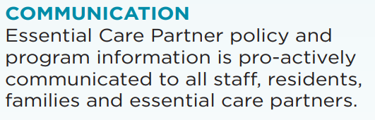
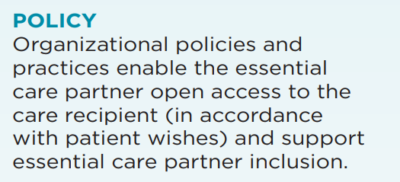
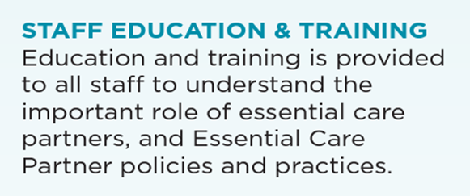
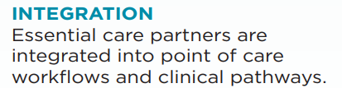
Enable and crisis-proof essential care partner presence
Shared commitment as partners in care
2025 – Supporting Dementia Care Partners: Everyone is a Change Agent
Notes:
When we talk about including the caregiver as part of the care team, we can support this with program communications templates, providing education or learning opportunities to caregivers, process and journey maps of an ECP program, and even policy examples that can support your organization as you roll out an essential care partner program. We also are happy to connect your hospital with other sites who have rolled out Essential Care Partner Programs in the past.

Slide 18
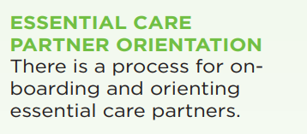
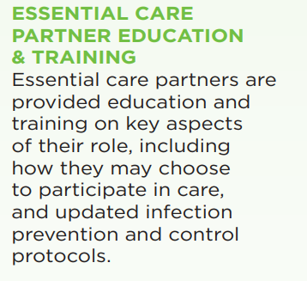
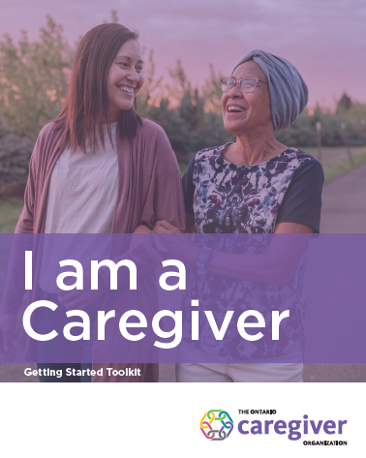
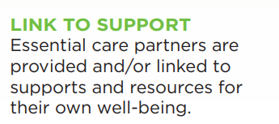
Understanding organizational processes and policies
Caregiving skills to support the care recipient
Care partner well-being
2025 – Supporting Dementia Care Partners: Everyone is a Change Agent
Notes:
And importantly, when we support the caregiver, we provide information on the OCO suite of programs and services, as well as resources like a helpline for caregivers to access, in order to take care of themselves as well. These include sharing resources on the programs and services that I mentioned today – so, the fact that you’re having me speak today about pretty much validates that you are already doing this piece of the puzzle, by equipping yourselves with information to support the caregivers of your organization!

Slide 19
Tools and Resources
2025 – Supporting Dementia Care Partners: Everyone is a Change Agent
Notes:
I’m going to go over a few tools and resources that caregivers can access – and a quick reminder to you – to think about what can you do to support caregivers in your everyday work as I run through these next few slides. I also want to point out Anne Marie who is my colleague from OCO, who is manning our booth with a number of these resources on the table. So please feel free to go take a look if you haven’t already to collect some resources and ideas to take home with you.

Slide 20
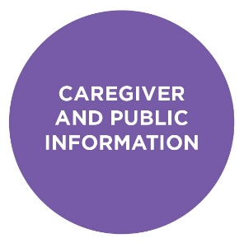
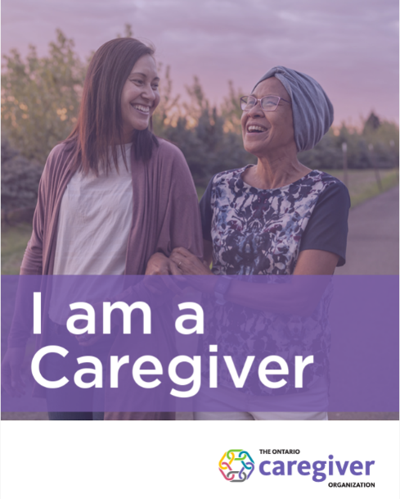
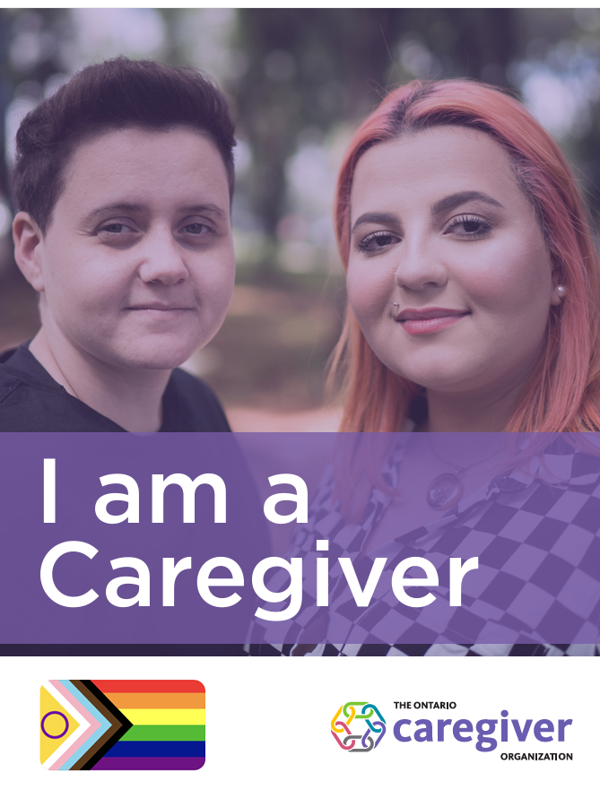
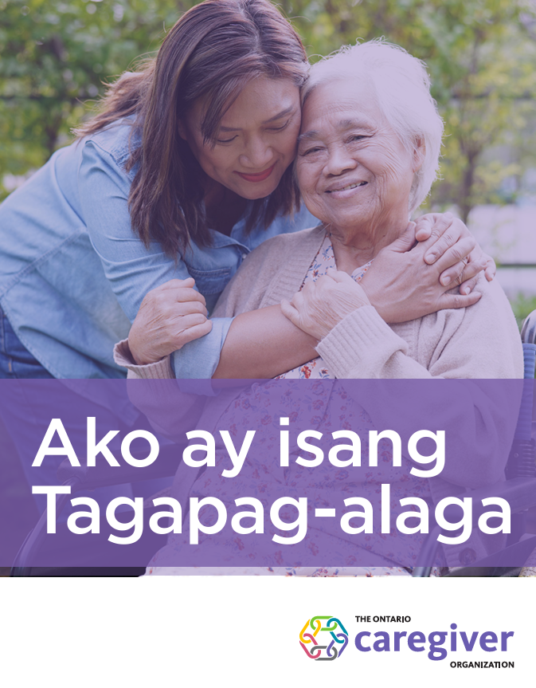
I am a Caregiver Toolkit
Information for new & experienced caregivers
Resources related to caregiver needs
Other useful information like OCO programs
The toolkit is now available in:
  Cantonese
  Mandarin
  Tamil
  Punjabi
  Tagalog
  French
  Black adaptation
  2SLGBTQAI+ adaptation
  Indigenous adaption
2025 – Supporting Dementia Care Partners: Everyone is a Change Agent
Notes:
One of the first resources we developed to support caregivers was the “I am a Caregiver” toolkit. This kit supports caregivers through key information that can help them in their role - how to develop a support team, understand their own needs and how to take care of themselves in order to avoid burnout.
This is a handy tool that helps caregivers identify the care recipients needs, their own needs and how to navigate them, taking care of themselves and building their support circle. The toolkit also outlines all of OCO’s caregiver programs and services, and is a helpful reference for someone may be unsure where to turn.
This has been adapted into nine different language and community versions, and I believe we just released two more languages as well. We recognized that there was a need to adapt the original version to reflect intersectional identities and underserved communities. You can see the versions we have on the screen – in Cantonese, Mandarin, Tamil, Punjabi, Tagalog, French, and versions for the black community, the 2SLGBTQIA+ and Indigenous communities. All of these toolkits are also available for download on our website. We are also happy to mail these out to your organization as well. Please send me an email after the presentation today, along with your mailing address and we would be happy to ship those out to you! https://ontariocaregiver.ca/toolkits

Slide 21
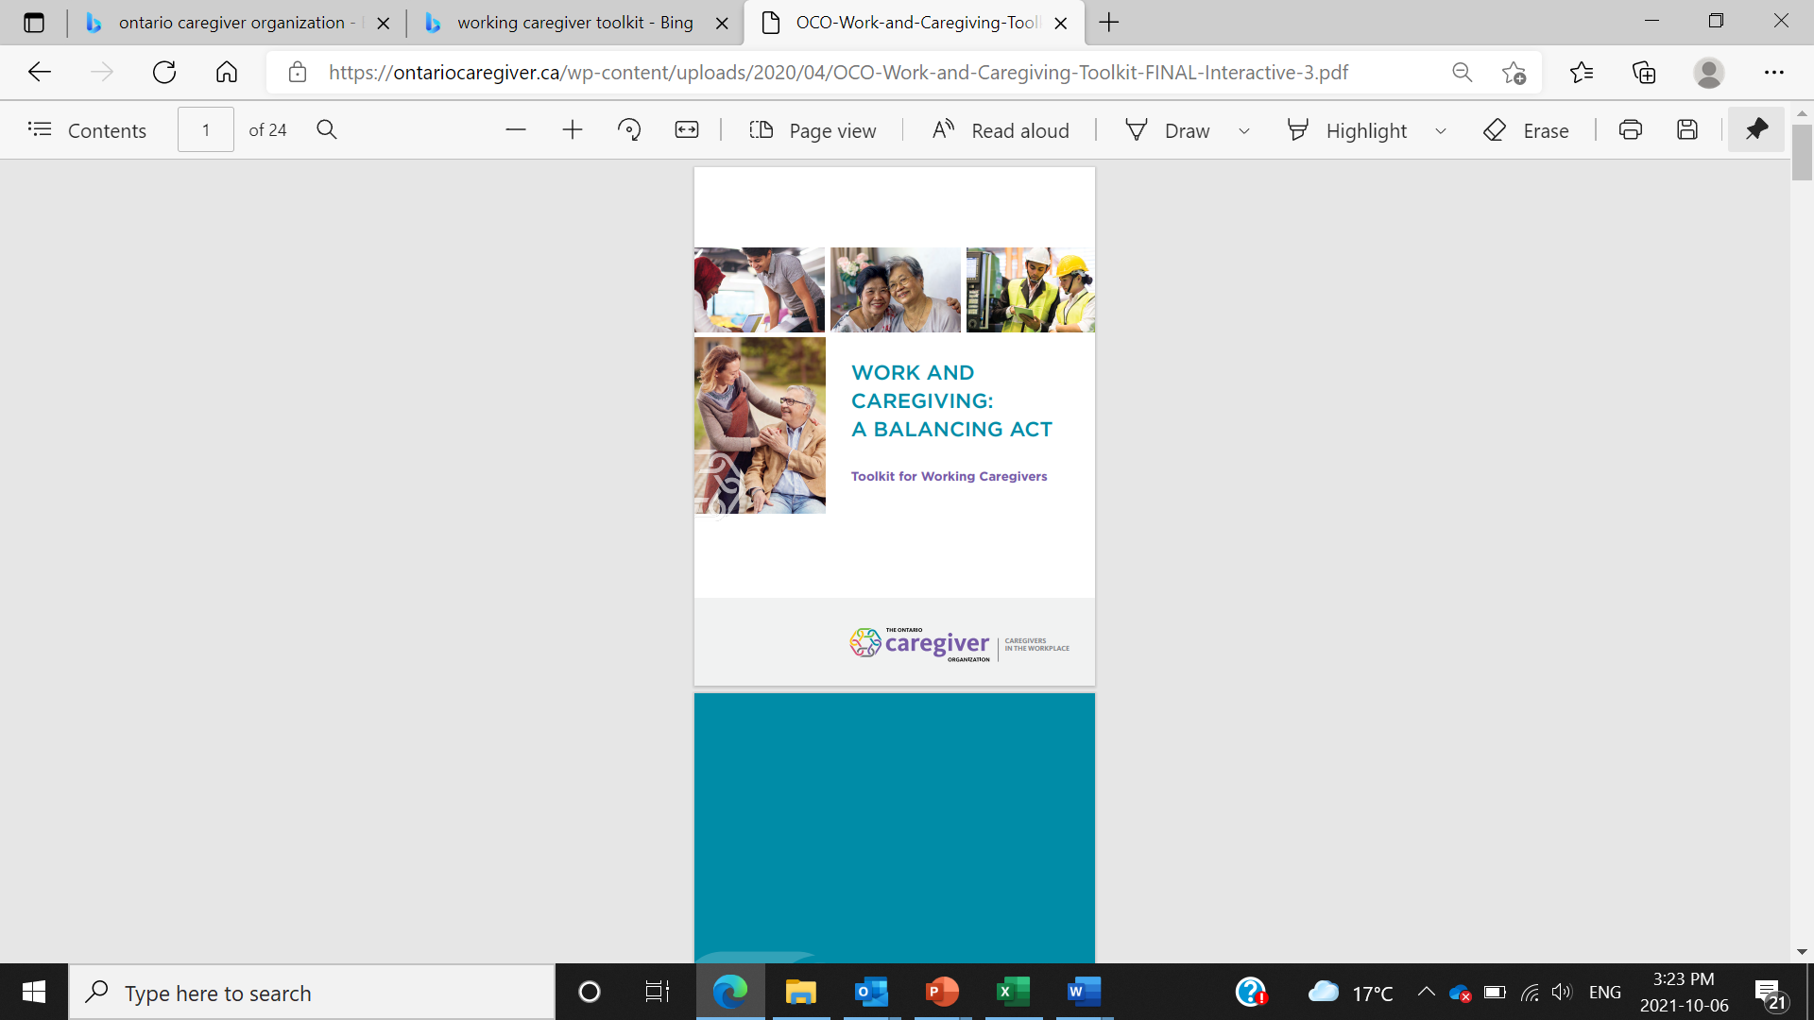
Working Caregiver Toolkit
67% of caregivers are employed
40% of working caregivers say they have considered quitting their job to provide better care
54% say balancing work and caregiving is stressful
34% worried about losing their job because of their caregiving responsibilities
2025 – Supporting Dementia Care Partners: Everyone is a Change Agent
Notes:
Perhaps some of you are, like myself, also caregivers – on top of being healthcare providers professionally. Balancing work and caregiving can be a challenge that 67% of caregivers face in our province, and this is having an impact on caregivers’ physical and emotional well-being, as well as their financial situation. Working caregivers are often stretched thin, and many wish they had more support from their employer to manage their work and caregiving responsibilities.
Aside from offering tools to help caregivers identify where they need support and how to start building a care team, and how to find services and support, The Working Caregiver Toolkit will also help caregivers learn about the options that may be available to them at work i.e. option to flexible working schedule, paid and unpaid leave benefits, EAP programs, as well as how to ask for support. You shouldn’t have to give up your job to be a good caregiver.

Slide 22
Programs and Services
2025 – Supporting Dementia Care Partners: Everyone is a Change Agent
Notes:
Here are some of the programs and services we offer at OCO.

Slide 23
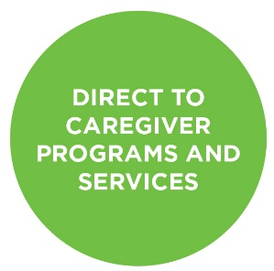
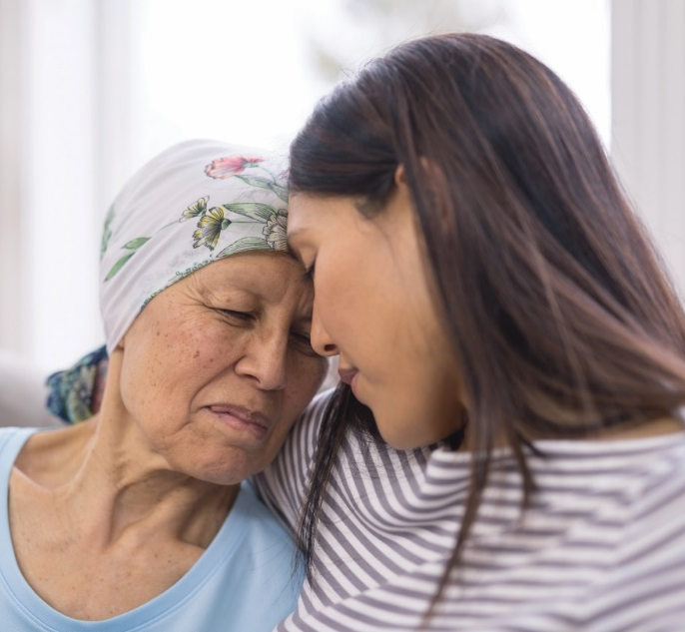
The Ontario Caregiver Helpline
1-833-416-2273 (CARE)
Phone support 24/7
Live chat Mon-Fri 7 a.m.
To 9 p.m. EST
Information and referrals connecting caregivers to the support they need
Available to all Ontario Caregivers in
multi-languages, free of charge
Confidential service
Not a crisis line
For more information:
https://ontariocaregiver.ca/helpline
2025 – Supporting Dementia Care Partners: Everyone is a Change Agent
Notes:
In terms of direct programs and services to caregivers, our helpline is a good place to start: it provides one stop to gather information about services in a specific community, and get connected to what a caregiver might need.
Community Resource Specialists have received specialized training, so they understand some of the unique challenges.
Operates 24/7 through telephone
Live chat Mon-Fri 7 a.m. To 9 p.m.
Answered by Community Resource Specialists who can provide information about your local resources and get you registered for OCO programs.
Available to all Ontario Caregivers in multi-languages, free of charge
NOT a crisis line but they can help you get connected to crisis services near you

Slide 24
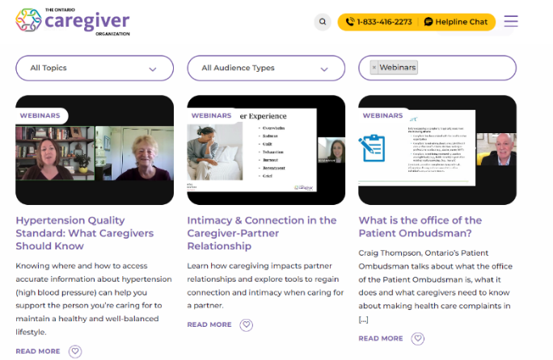
Webinars for Caregivers
New topics each month (live & recorded)
Topics cover:
  Caregiver Health & Well-Being
  Emotions and Caregiving
  Caregiver Skills and Personal Development
  Financial & Legal Tips for Caregivers
  Managing Care
  Caregiving and Specific Health Conditions
  Recordings are available at: https://ontariocaregiver.ca/webinars
2025 – Supporting Dementia Care Partners: Everyone is a Change Agent
Notes:
Our webinars (offered in English and French) are a very popular resource, and we often hear from providers that they have passed on a particular one to a patient and/or their family based on their relevance to their particular situation. We continue to cover a wide range of topics, with a strong focus on webinars aimed at caregiver well-being ,to help caregivers feel less alone and provide them a variety of info and resources to help them in their role.
Previous webinar topics include: Transforming Caregiver Guilt and Resentment, Caregiving, Conflict and Compassionate Communication, Health Sleep Habits, Cultivating Mindfulness for Well-being, Financial Planning, Advance Care Planning, Nutrition, Caregiving and Eating Disorders, The 8 As of Dementia, The Importance of the Caregiver-Pharmacist Relationship, etc, etc (list is long!)
All of our webinars can be viewed “live” with registration (free), but are also recorded and available on our website anytime.

Slide 25
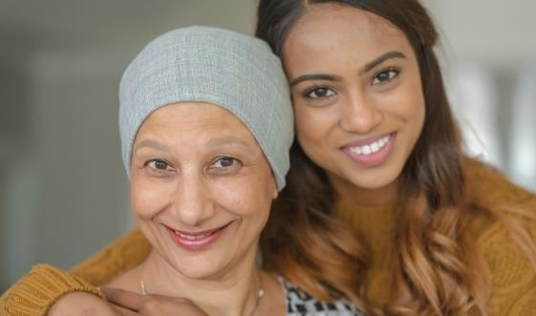
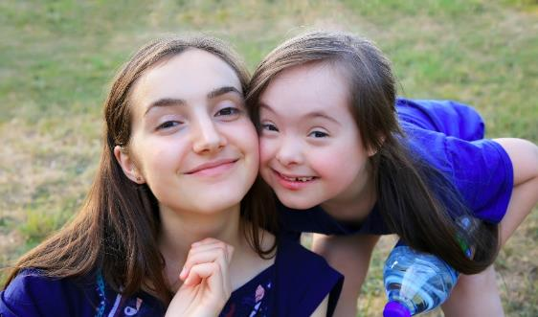
Peer Support Programs
Online Support Groups
Groups on various days and times
Co-facilitated by two trained caregivers
Caregivers can register at:
www.ontariocaregiver.ca/peersupport
1:1 Peer Support Program
Connect with a Peer Mentor over the phone and receive emotional support & validation
Caregiver participants must be at least 16 years of age
2025 – Supporting Dementia Care Partners: Everyone is a Change Agent
Notes:
OCO also offers 1:1 and group peer support. Groups run twice a month virtually, and are facilitated by trained caregivers.
1:1 Peer Mentor support allows caregivers to connect 1:1 with an experienced caregiver. Matches can last up to 6 months, and mentors receive training from OCO on how to be a mentor, but more importantly they have a wealth of experience and knowledge which can help another caregiver with the challenges of their caregiving situation

Slide 26

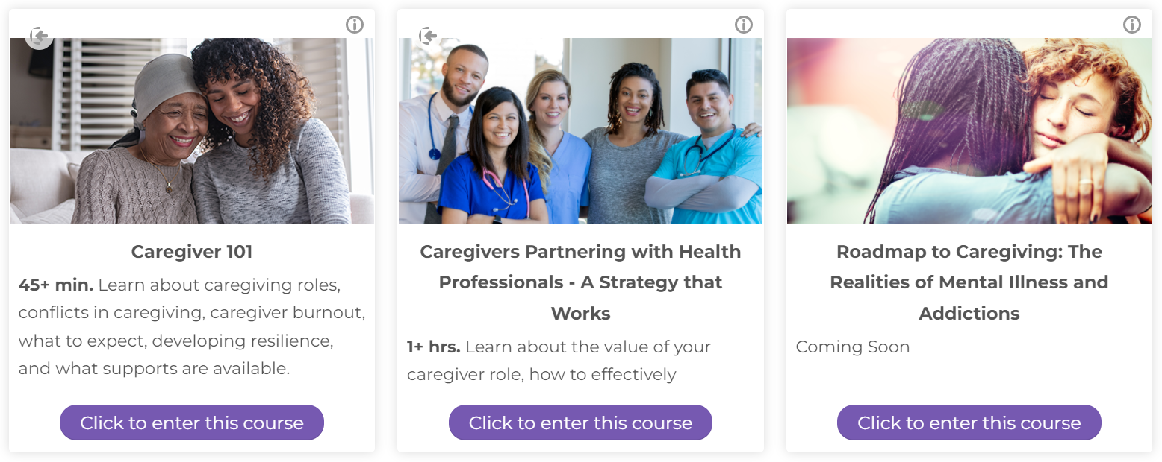
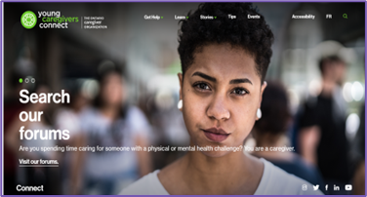
More Programs and Services for Caregivers
Toolkits/Tip Sheets
E-Learning
Time to Talk Podcast
90 Second Caregiver
Young Caregivers Connect
Webinars
Caregiver Coaching
SCALE Program
2025 – Supporting Dementia Care Partners: Everyone is a Change Agent
Notes:
In addition to the resources I’ve just reviewed, like the toolkits, helpline, webinar, peer support programs, there are lots of other information on our website, and I encourage everyone to explore – whether you are looking for resources for yourself as a provider or perhaps a caregiver, or for something to share with your patients and their families. I’ve put this slide here because these resources are both in the green and purple categories of supports that OCO provides. These resources include: a Time to Talk podcast for caregivers, OCO-developed e-learning modules for caregivers and care providers, a newsletter called the 90 Second Caregiver (hint: it only takes 90 seconds to read, once per week!), and a website called Young Caregivers Connect that has an online forum, links to peer support, and learning resources.
The Caregiver Coaching Program is a limited, eligibility-based service and includes:
Up to six 1:1 support sessions to work-through caregiving challenges (by telephone or Zoom)
Problem-solving and goal-setting strategies to help unpack complex or overwhelming caregiving difficulties
Strengthening resilience skills to help manage stress
Strategies, resources, and information tailored to suit caregivers needs
Motivational support to make the necessary changes within the caregiving role
Accountability for action-items
“SCALE” (which stands for Supporting Caregiver Awareness, Learning & Empowerment) is our signature program. SCALE aims to empower caregivers with practical information, and skills to enhance self-awareness with a focus on one’s own emotions, needs, and well-being. Like all of our other programs, it is FREE; it runs twice per year and consists of a series of eight webinars facilitated by contracted mental health professionals. Caregivers can attend them live or access the recordings. Participants can register for all or only some of the weekly webinars. They don’t have to commit to all eight but viewing all of them is recommended. Those who register for webinars may also choose to sign up for limited individual or group counselling sessions with the facilitators during the 8-week program. These sessions allow one to dig a little deeper to work through their emotions related to caregiving.
Our winter session started February 4 (Feb 6 for the French version), and registration is still open on our website. Caregivers can self-register.

Slide 27
Reflections and Actions
2025 – Supporting Dementia Care Partners: Everyone is a Change Agent
Notes:
Now I’ll turn it over to Jennifer to guide you through our Reflections and Actions Activity.

Slide 28
What resonated with you today?
2025 – Supporting Dementia Care Partners: Everyone is a Change Agent
Notes:
Dr Hennessy called us to be mindful. What small thing can I do to be more present?
Tailoring tasks and activities to support changing needs and abilities - identifying strengths and abilities vs focusing on lost abilities, what a person can no longer do
Providing support through transitions in the community - key takeaways?
Advance Care Planning - who would you want to make decisions for you if you were not able? What does quality of life look like for you? Reflecting on values and beliefs?
This afternoon we heard about:
Teepa Snow’s Positive Approaches to Care - how do we coach our CG in understanding the experience of the PLWD and adapting how they communicate to support understanding, validation, and connection
Problem solving techniques - how do we help CG to think about the challenges they are living, and support them in setting small goals
Navigating transitions in LTC
Self-Compassion

Slide 29
Start with one small thing you can do tomorrow
Is it an action?
Be specific
Start small
2025 – Supporting Dementia Care Partners: Everyone is a Change Agent
Notes:
SMART goals

Slide 30
Doing something new or different.
Is it important to you? Why?
Can you do it?
Does it fit within your role?
2025 – Supporting Dementia Care Partners: Everyone is a Change Agent
March 2025 – The Ontario Caregiver Organization
Notes:
Capability refers to whether we have the knowledge, skills and abilities required to engage in a particular behaviour.
Opportunity: in the context of this model, opportunity refers to the external factors which make the execution of a particular behaviour possible
Motivation: the internal processes which influence our decision making and behaviours

Slide 31
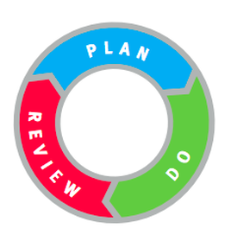
Now what?
2025 – Supporting Dementia Care Partners: Everyone is a Change Agent
March 2025 – The Ontario Caregiver Organization

Slide 32
Now what: easy ideas to implement
Visit our booth, and reach out to a Regional Lead or Implementation Lead to get connected to our resources!
Check out our Essential Care Partner Support Hub website: https://ontariocaregiver.ca/essential-care-partner/overview/
Attend an upcoming Learning Collaborative Event or subscribe to OCO’s newsletters: https://ontariocaregiver.ca/contact/subscribe/
2025 - March
Notes:
What are you able to do right now? You can you can check out our website, attend a Learning Collaborative Event, or subscribe to OCO’s newsletters – Learning Collaboratives (and newsletters) are open to any clinician, leadership staff, or patient, and act as a community of practice to share information and learn from others on implementation topics. We’re so grateful to be a part of this group, and moving forward, you will actually have two staff that you’re working with - myself, and Bianca Feitelberg, who is a Project Lead for Ontario Health Teams who you may see at a future meeting.

Slide 33
We all have the ability to make a difference.
What ‘identify, include, and support’ looks like is up to you.
One small change can have a big impact.
2025 – Supporting Dementia Care Partners: Everyone is a Change Agent
Notes:
If you could take away a few notes with you from our sessions today – its that we all have the ability to make a difference to set us up for better health tomorrow. One small change can have a big impact. Better health for caregivers and better health for care providers means better health for our patients.

Slide 34






Thank you!
Jennifer Cavanagh
jcavanagh@bruyere.org
Melissa Ngo
melissan@ontariocaregiver.ca
Ontario Caregiver Organization
www.ontariocaregiver.ca
Geriatric Psychiatry Community Services of Ottawa
www.gpcso.org
2025 – Supporting Dementia Care Partners: Everyone is a Change Agent
Notes:
This brings me to the end of our presentation, please feel free to connect with us afterward should you have questions or would like resources. Thanks everyone for your time!

