Slide 2
Seeing It From The Other Side
Mary Mullin – PRC Renfrew County
Bonnie Daros – PRC Ottawa
Lana MacDonald – RN Royal Ottawa Mental Health Centre
Tatiana Vavrova - RN Royal Ottawa Mental Health Centre
2025

Slide 3
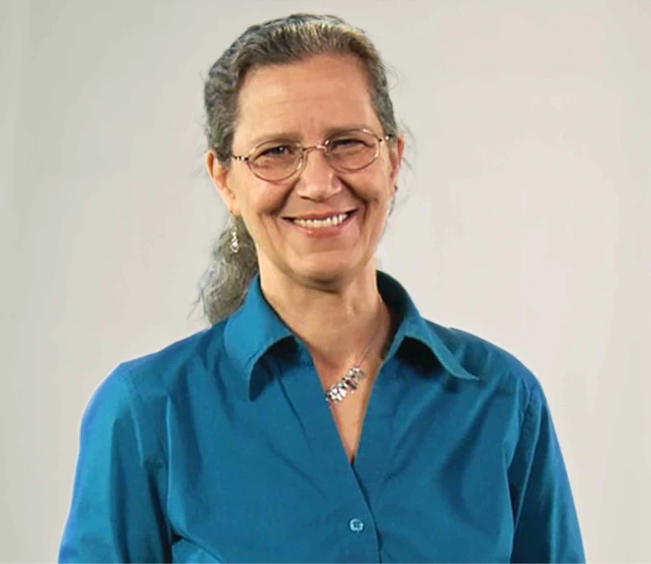
Teepa Snow
Teepa Snow and her company Positive Approach to Care (PAC) offer both a theory to help you understand what is happening to the brain, paired with practical techniques so you can not just survive, but thrive as a care partner. With over 40 years of experience, dementia expert Teepa Snow and her PAC Team can help you overcome challenges.
https://teepasnow.com

Slide 4
When it comes to dementia, it is not all about the disease…it is about human nature.
We need to realize it is more about our relationship with each other: what is the same, what is changing, what we don’t like, what they don’t like.
The goal is to help you help your family member or friend – through helping you see it from their side – empower you with awareness not guilt.

Slide 5
You have noticed the symptoms
Trouble with new information
Misremembering
Misinterpreting what you said
Difficulty finding words
Trouble with comprehension
Getting turned around

Slide 6
50% of people with early signs of dementia have no awareness they are affected. It is not just memory that is affected but self awareness (how accurate I am at assessing my own abilities)
“Everyone makes mistakes.”
“It’s no big deal!”
“I’m fine”
You try to help BUT they do not have self awareness.
“You need to shower”
“You can’t drive it is not safe”
“You took that pill already”
Trying to get them to see. Arguing and frustration on everyone’s part.
Notes:
Have people sit next to someone. Put up the 10 fingers – close 1 fist. Of these 10 people, 50% of people with early signs of dementia have no awareness they are affected.
What does the closed fist remind you of? Answer: a fight.
Turn to your partner -1 person be the caregiver and say to the person with dementia; “You need some help.” The other person with their fist answers back, “I don’t need your help. I am fine. Shut up”

Slide 7
50% of people living with dementia have awareness that something is happening to them. They typically will respond in 1 of 2 ways:
30% of people living with dementia realize they are losing skill – it makes them nervous and anxious!
“What is wrong with me?”
“I should know this”
“What do I do next?”
They then look to the caregiver – someone who knows what to do and…
“Don’t leave!”
“Where are you going?”
Notes:
Discuss here the strength versus skill fingers on the hand - the pinky and 4th finger are the strength fingers – holding a jar etc while the first 3 fingers are for skill: writing, doing up buttons
Show the skill fingers attaching onto the caregiver.

Slide 8
I am who I was but I am changing.
Our relationship is changing

Slide 9
Problem is the constant need for them to be with you:
They cannot realize it is wearing you out
The person with dementia sees that you are more frustrated with them
You seem to want to spend time away – causing more anxiousness and increased need to be with you.
The person with dementia:
“I notice I need more help. I trust you. We have a long term relationship. What I can’t see is that I am wearing you out.”

Slide 10
The caregiver must early on build a team!!
If you do not recognize their need for support, by the time you are worn out and you try to detach – the person is so used to you that they won’t accept anyone else.
Ease the person in slowly to new relationships
Continue to stay connected while new relationships are being created
Go slow
Not only family members and friends but professional caregivers

Slide 11
The second way people respond who have awareness that something is happening to them is:
2) 20% of people living with dementia are aware of skill loss – this makes them feel a loss of control and they don’t want anyone else to notice and think less of them. They have always been in charge, ran things.
“Let’s talk about it later.”
“I don’t need your help.”
“I’m fine.”
Notes:
Show the 2 strength fingers

Slide 12
Start withdrawing – wont go to events, the doctor etc.
Leave everything out
Sorting
Territorial
Wont throw things away
Lots of notes
Insist on looking and doing things later – bath, change clothes…
What are they most scared about?
Notes:
Answer: someone noticing they are losing their abilities.
They may tell you to go. Fire people you hired etc.

Slide 13
The worse thing you can do is notice their loss with your behaviour and point out what they are doing wrong.
Notes:
It can be hard and tempting to try and fix it all but it causes more grief.
Spend a few minutes talking about some of those uh oh moments you may have had with your partner.
Taking a time out to respond rather than react is an important strategy.

Slide 14
Teepa Snow’s Five I’m Sorry Phrases
Sometimes as Care Partners we make mistakes and need to apologize.
Sometimes as Care Partners we don’t make mistakes but we still need to apologize.
We must look at situations from the point of view of the person living with dementia to understand when and where Teepa Snow’s five, “I’m sorry,” phrases will be needed to keep the relationship strong and valuable.

Slide 15
INTENT
I’m sorry, I was trying to help..
CHALLENGINGCHANGE
I’m sorry, this is hard.
EMOTION
I’m sorry I made you angry.
TEEPA’S FIVE
I’M SORRY’S
PERCEPTION OF EVENT
I’m sorry, that should NOT have happened.
INTELLECTUAL CAPACITY
I’m sorry, I had no right to treat you like a child
Notes:
Intent: When we are just trying to help but the PLWD thinks you are being mean, frustrating, intrusive, bossy
Emotion: When the PLWD is expressing to us that they do not like how we are making them feel.
Intellectual Capacity: When the PLWD is expressing that they are upset at being told what they can and cannot do – that they are a smart and capable adult.
Perception of the Event: When the PLWD has different memories and beliefs about events causing different reactions.
Challenging Change: When something is no longer OK – not safe, not working, not an option.

Slide 16
The Caregiver Agenda
Video with Teepa
Notes:
14 minute video – show whole video

Slide 17
Vision Changes and
Positive Physical Approach

Slide 18
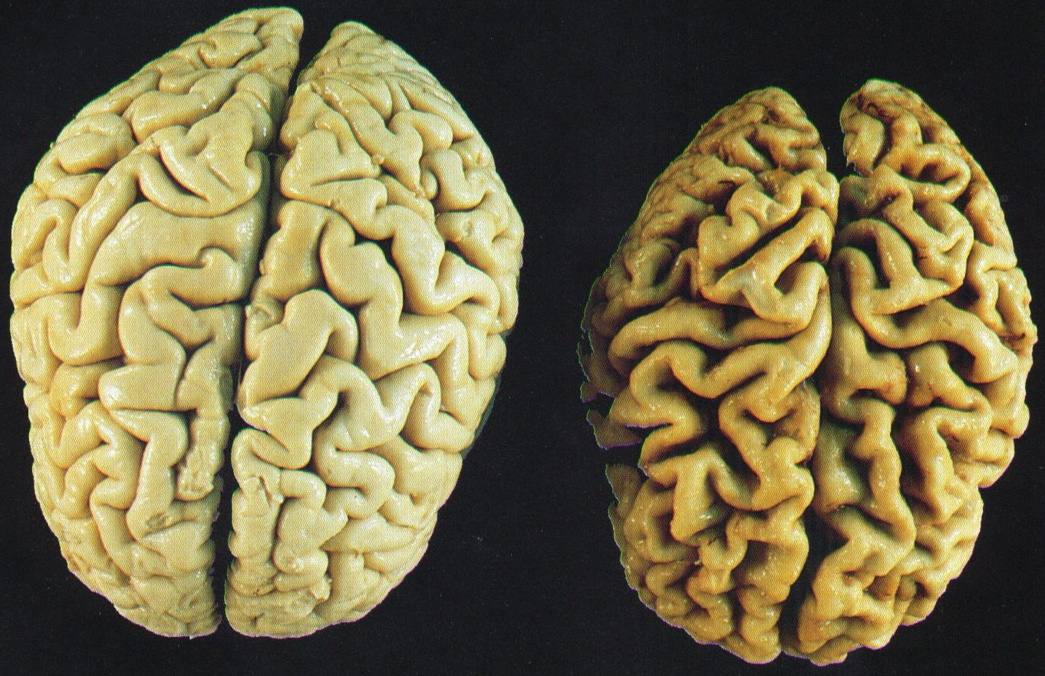
Vision Center – BIG CHANGES

Slide 19
How Can We Give Information?
Order of Cues
Visual Cues – SHOW
Verbal Cues – TELL
Tactile Cues – TOUCH
Source: PAC Certified Independent Coach Manual

Slide 20
3 Zones of Human Awareness
Public Space
More than 6 ft away
Visual awareness and social interactions
Personal Space
6 ft to arm’s length
Friendly and personal conversations
Intimate Space
Within arm’s reach
Intimate touch or connections
Source: PAC Certified Independent Coach Manual

Slide 21
Positive Physical Approach (PPA)™
Step 1: Moving 6 ft out
Pause at the edge of public space
Stop moving at 6 ft
Let the person NOTICE you in public space
Give them time to do this
Acknowledge the Person’s OWNERSHIP of personal space
Respect their space!
Source: PAC Certified Independent Coach Manual

Slide 22
Positive Physical Approach (PPA)™
Step 2: Greet-Give “hi” sign
Bring flat, open palm up near face
Visual cue to look at you. Say “Hi!” and use preferred name, if known
Verbal cue to look at you
Look friendly
Smile
Make eye contact
Source: PAC Certified Independent Coach Manual

Slide 23
Positive Physical Approach (PPA)™
Step 3: Say name, offer hand
Seek permission to enter PERSONAL SPACE
SHOW person what you want to do
Watch for their reaction/response
If there’s hesitation
STAY in PUBLIC space
Turn your body SIDEWAYS – supportive stance
See what happens next – no better? Hold back
Source: PAC Certified Independent Coach Manual

Slide 24
Positive Physical Approach (PPA)™
Step 4: Move slowly
Move slowly towards the person
While offering your hand in greeting, smile and look friendly
1 second = 1 step
Respect SLOWED processing time
Decreased ability to do two things at one time
Source: PAC Certified Independent Coach Manual

Slide 25
Positive Physical Approach (PPA)™
Step 5: Move into SUPPORTIVE stance
Shift toward dominant side – hand shake side
Turn your trunk sideways to the person
Stay at ARM’S length
Keep face and chest back
Source: PAC Certified Independent Coach Manual

Slide 26
Positive Physical Approach (PPA)™
Step 6: Hand-under-Hand™
Go into Hand-under-Hand™ from a normal handshake
Provides protection for them AND you
Connects you with them while giving them a sense of control
Source: PAC Certified Independent Coach Manual

Slide 27
Positive Physical Approach (PPA)™
Step 7: Move to side, get low
Get to their level
Sit, kneel or squat
Respect INTIMATE space
Allow eye contact with limited visual field
Get focus on your face not your chest or middle
Source: PAC Certified Independent Coach Manual

Slide 28
Positive Physical Approach (PPA)™
Step 8: Make connection
Make friendly statement
Wait for a response or acknowledgement
Be sure you have a connection before you start your care
Source: PAC Certified Independent Coach Manual

Slide 29
Positive Physical Approach (PPA)™
Step 9: Deliver a message
Give visual cues first
Offer verbal information next
Use touching last AND only if the person is aware of your plan
Source: PAC Certified Independent Coach Manual

Slide 30
Until there’s a cure there’s care
Thank You
Questions?

