Slide 1
Person-Centered Dementia Care:
Focusing on Spared Abilities &
Tailoring Activities to Meet Changing Needs
Geriatric Psychiatry Community Services of Ottawa
Kaitlyn Borutskie, BScN, RN
Notes:
April 9th, 2025
60 minutes
Pembroke
Champlain Dementia Network – Supporting Dementia Care Partners: Everyone is a Change Agent

Slide 2
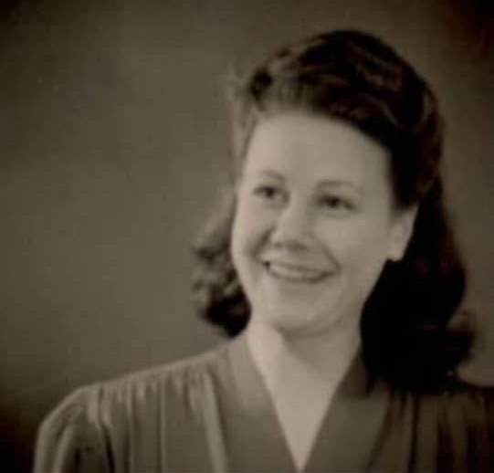
Today’s session will focus on…
Applying a person-centered framework
Highlighting the role of personhood
Exposing remaining needs, interests, skills, abilities
Tailoring activities in response to cognitive and physical function decline
Notes:
We’re going to start today by discussing how to apply a person-centered framework to the work that we do highlighting the role of personhood,
We’ll look at how to expose remaining needs, interests, skills & abilities for PLWD, and of course
Discuss how to tailor activities for changing needs and do some group work to practice.

Slide 3
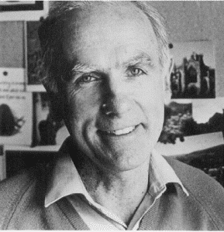
Person-Centered Dementia Care
Core Principles:
Valuing all human life regardless of age and mental abilities
Rooted in respect for the other and knowledge of their personhood
Paying attention to the person as a whole - not their symptoms
Understanding the world from the perspective of the person living with dementia
Thomas Kitwood (1937-1998)
(Bolby Sifton et al., 2011)
Notes:
A pioneer in the field of dementia care, Thomas Kitwood, dedicated his life’s work to understanding the lived experience of what care is like for the person living with dementia.
According to Kitwood, the person-centered approach is to see the person with dementia as an equal person. One with feelings, rights, desires and a rich life story that existed long before the diagnosis of dementia.
We need to remember that PLWD are people first.
The Core principles:
Valuing all human life regardless of age and mental abilities
Being rooted in respect for the other and knowledge of their personhood
It means paying attention to the person as a whole, not just their symptoms
And understanding the world from the perspective of the person living with dementia

Slide 4
Personhood
The qualities that make up a person’s unique identity, values, beliefs, and sense of self
Rooted in dignity, respect, trust
Supporting older adults while respecting their desire for autonomy and independence
Acknowledging personhood involves our dedication to knowing who the person is, past and present, and incorporating this into their care plan as they journey through dementia
Notes:
Personhood is really the essence of what makes someone a person, encompassing their own unique identity, beliefs, values, and sense of self. – Who this person is at their core.
Dementia can affect a person's ability to think, recall memories, communicate, and connect with others, potentially undermining those qualities that define who they are.
Person-centered care aims to recognize and support the personhood of individuals with dementia, ensuring they are treated with dignity and respect, while respecting their desire for autonomy and independence.

Slide 5
Person-Centered Dementia Care
Six psychological needs that are essential to all people:
Love: unconditional acceptance and empathy
Comfort: security, warmth and proximity
Identity: connection to oneself (past and present)
Attachment: our connections in life
Inclusion: being part of a social community; acceptance
Meaningful occupation: the ability to participate in your own life in such a way that you use your abilities, strength, and experience. That you are needed & have something to do
(Bolby Sifton et al., 2011)
Notes:
Coming back to the work of Thomas Kitwood, He emphasized six psychological needs that are essential to all people, dementia dx or not.
Love – Being loved and accepted is part of our need for survival from the time we’re born. Everyone needs to feel love and express love. This love can range from loving a person, activity, higher power, and of course self-love.
Comfort – We all have a need to feel warm, dry, clean, to be pain free, have freedom of movement, a sense of closeness with others.
We all have the need for a personal identity – From the clothes we chose to wear today, to how we do our hair and what food we like to eat all contribute to our sense of identity and who we are at our core. These factors help us & others identify with who we are.
Attachments – Everyone wants to feel connected to someone, something, or a combination of both & these connections in life are crucial to our feelings of wellbeing.
Inclusion means that we want to be part of something. If we feel left out, then it makes us feel bad. People living with dementia may lose track of conversation easily, being mindful of their feelings of inclusion is important.
Meaningful Occupation – We have a need to be occupied with things that are meaningful to us & that make us feel like we have worth and purpose in life & PLWD have that same need.

Slide 6
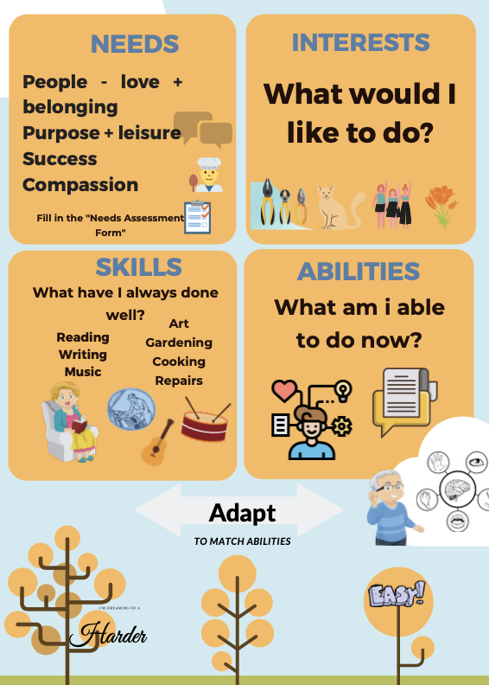
Notes:
This is a nice poster that will be central to planning activities. We must always consider someone’s needs, interests, skills, abilities and then adapt our activities to be easier or harder as needed match them to abilities.
We just looked at how PLWD have the same core needs as all of us – To love, feel purposeful, successful, included, comfortable
Considering skills & interests – This ties in our personhood aspect. What has this person always done well and enjoyed? What are their likes and dislikes?
And finally, abilities – What is this person able to do? This can be where we get really stuck.

Slide 7
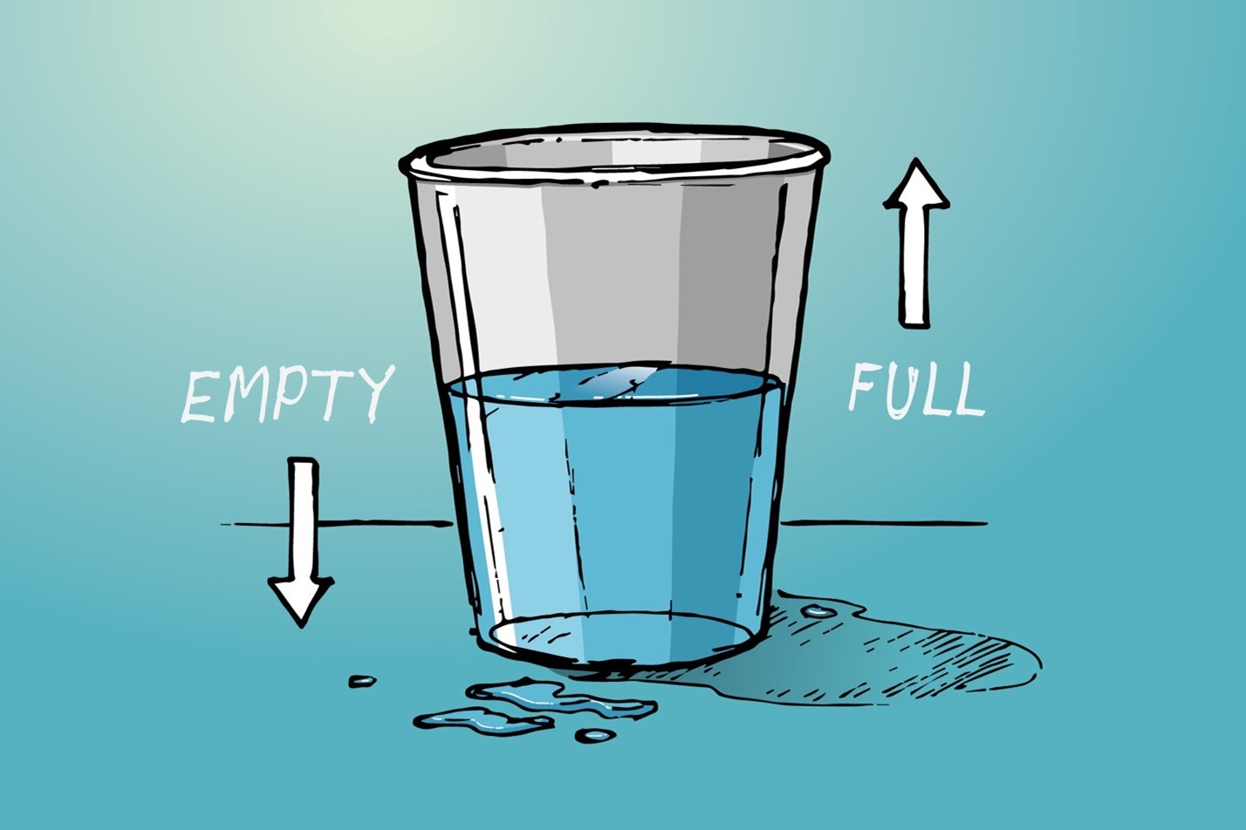
Paradigm Shift: Spared Abilities
Shifting the focus from deficits to spared abilities
Habitual skills
Humour
Emotional memory & awareness
Sociability
Sensory appreciation & awareness
Motor function
Musical responsiveness
Long-term memory
(Bolby Sifton et al., 2011)
Notes:
We want to expose the person’s abilities and shift our focus away from ‘deficits’ or ‘losses’. By doing so, we minimize the potential for excess disability.
We may consider this with the glass half-full vs half-empty metaphor – Are we focusing on the loss, negative and potential problems – Or are we focusing on the positive, and optimistic even in trying times.
These are eight spared abilities which we’re going to discuss in a bit more detail, and they suggest that persons living with dementia have more skills & abilities than we sometimes recognize.

Slide 8
1. Habitual Skills
AKA ‘Procedural memory’ – HOW we do things
Triggered by familiar cues associated with the action
Ex. Sweeping the floor when handed a broom
Ex. Brushing teeth when handed a toothbrush
(Bolby Sifton et al., 2011)
Notes:
Habitual skills and remembering “how” we do things is associated with our procedural memory. This is a type of long-term memory that stores information on how to perform tasks or skills without conscious awareness.
We might consider these as things we do automatically, without needing to think about it. E.g. Brushing our teeth or hair, shuffling a deck of cards, threading a needle – Things you ‘just do’ but we are relying on memory & this procedural memory system is triggered by familiar cues that are associated with the action.
For example, being seated at a dining room table with prepared foods triggers the response to begin to eat. Being handed a bowl of partially mixed batter and a spoon triggers the response to stir the batter.
Research demonstrates that persons with dementia retain procedural memory skills until later in the disease .

Slide 9
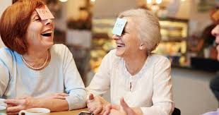
2. Humour
Sense of humour persists, in spite of increasing difficulties with communication.
Considering laughter as ‘medicine’ or a therapeutic intervention.
Appreciation for limitations relating to reduced language and understanding.
(Bolby Sifton et al., 2011)
Notes:
Despite PLWD experiencing increasing difficulties with communication, the sense of humour persists, and a good laugh is therapeutic.
Humor should never be laughing at, but rather with the person. We want to understand what types of humor appeal to them, long-standing family jokes, or favourite stories. We might play some old-time favourite performers to bring forth their laughter.
It is essential to appreciate limitations in language and understanding.
Complex verbal jokes are usually not understood but by accenting the humour in a situation by mime or exaggeration is a good, non-verbal source of humour and communication.

Slide 10
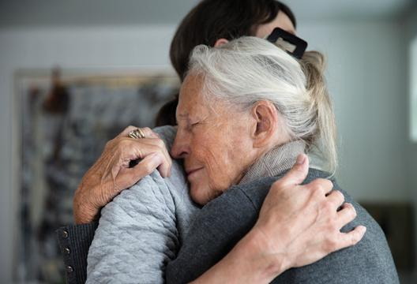
3. Emotional Awareness
Retained capacity for:
Expressing and giving love / affection
Experience a full range of emotion
Sharing warm interpersonal relationships
Participating in meaningful activity.
Enhanced emotional sensitivity
Many activities encourage non-verbal emotional expression:
Caring for plants & pets
Listening to favourite music or singing
(Bolby Sifton et al., 2011)
Notes:
When it comes to emotional awareness, we’ve come to learn that the person living with dementia has retained the capacity for:
Expressing and giving love & affection
Experiencing a full range of emotions from joy to fear, sorrow, anger, etc.
They can share in warm interpersonal relationships
& participate in meaningful activities.
And their emotional sensitivity is not only retained but enhanced. Leading them to become very aware & susceptible to picking up on the emotions and moods of others.
This invites us to be aware of our facial expressions, tone of voice, and reflect how our own mood or energy may be transferred to the person living with dementia
Even though emotions are felt, it becomes more difficult for persons living with dementia to express these emotions with their words but there are many activities that can encourage non-verbal emotional expression.
Caring for plants or animals even if it’s a robotic animal or baby doll, can provide those feelings of caring and affection.
Listening to music or signing are also excellent to transport someone through time and connect with happy feelings associated with the music

Slide 11
4. Sociability
AKA overlearned social skills
People living with dementia retain the ability to socialize and engage in social activities
Special considerations:
Social activity requires a great deal of energy and concentration, which may leave the person feeling fatigued afterwards. Balance is key!
Be mindful of overstimulation
(Bolby Sifton et al., 2011)
Notes:
People living with dementia tend to retain the ability to socialize and engage in social activities
It is important to remember that these activities require a great deal of energy and concentration, and that the person living with dementia may need extra rest and quiet afterwards. While social gatherings help to support their self-esteem, there must be balance.
Large and noisy gatherings may overwhelm the person with too much stimulation.
One thing we do need to be aware of is not mistaking social skills for the persistence of higher skills such as memory .
Many persons living with dementia present well, particularly in the early and middle stages, covering their losses by demonstrating good social skills.
It is an excellent coping mechanism in social situations but may lead us to overestimate their abilities (i.e., thinking they are more capable than they are).

Slide 12
5. Sensory Awareness
Experiencing touches, smells, movement, sights, sounds and tastes of everyday life can serve as an ongoing source of pleasure, stimulation, and method of communication.
Special considerations:
Dementia can impair their ability to understand or recognize what the senses are telling them, and to decide what action to take (e.g., misperceptions, illusions)
Be mindful of overstimulation.
(Bolby Sifton et al., 2011)
Notes:
The primary sensory areas of the brain remain relatively untouched by the dementia processes.
Experiencing touches, smells, sights, sounds and tastes of everyday life can serve as an ongoing source of pleasure, stimulation, and method of communication.
We all take in the world through our senses, interpret what it means based upon our experiences, and then act accordingly.
Perhaps you always had lavender in your home or big lilac bushes at the front door, and when you smell these, it reminds you of home and makes you feel secure. When we know someone’s personhood, we might pickup on ways to incorporate that into their care through the senses.

Slide 13
6. Primary Motor Function
Strength and muscle control persist until the late stages
Movement brings enjoyment and improved health outcomes:
↑ range of motion
↑ circulation
↑ bowel / bladder function
Improved breathing and heart function
Appetite
Energy
Special considerations:
The ability to move continues but the person may need help getting started as the disease progresses
(Bolby Sifton et al., 2011)
Notes:
Although persons living with dementia may experience gait changes early in the disease, strength and muscle control usually persist until the late stages.
At all stages, movement brings not only enjoyment & pleasure but also has lots of positive health benefits.
While the ability to move continues, the person may need help getting started as the disease progresses.
The best way to initiate movement is to use familiar activities (thinking back to procedural memory), such as sweeping, raking leaves, folding laundry, hanging the clothes, dancing. All provide good exercise and involve familiar movements.
Games of catch are also great as the catching reflex is present long into the disease process.
Music is one of the best ways to encourage people to move.

Slide 14
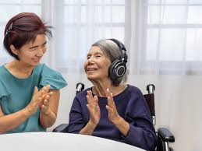
7. Music
Areas of the brain involved in appreciating, responding to, and becoming involved in music are typically well-preserved.
It can bypass communication deficits.
Provides an important avenue for emotional expression.
Special Considerations
Tailor music choice to individual preferences
Choose music from the era of their mid-teens to mid-20’s for best recall
(Bolby Sifton et al., 2011)
Notes:
That brings us to our 7th spared ability.
Areas of the brain involved in appreciating, responding to, and becoming involved in music are typically well-preserved.
Music can bypass communication deficits (e.g., if the person has significant aphasia and cannot articulate words or sentences but hears a familiar song and then begins singing all the words – it is quite fabulous).
Music can bring life to someone’s day but can also be calming depending on the type.
It provides an important avenue for the expression of emotion.
Of course, in keeping with person centered care, learn about the persons musical preferences, not everyone likes every genre.
Aiming for music that they would have listened to in their mid-teens to mid-twenties age range is usually best recalled.

Slide 15
8. Long-term Memory
Intact in the early / middle stages
Less impaired with progression of disease
Events of personal significance are most memorable
E.g. Wedding day, Graduation, Birth of children
Memories of childhood and young adulthood are better preserved than more recent memories
E.g. Will not remember something that happened 5 minutes ago vs will remember an event that occurred 50 years ago
(Bolby Sifton et al., 2011)
Notes:
Finally, Long-term memory is less impaired & more intact in the early to middle stages
Events of personal significance (e.g., birth of child, first car, marriage, or personal accomplishments) are those most usually recalled.
As the disease progresses, the details about these events may become spotty, but with familiar verbal and non-verbal cues, even persons with advanced dementia can usually recall some fragments.
By stimulating these long-term memories it encourages verbalization, improves mood by recalling happy experiences, and enhances self-esteem by reaffirming the value of life experiences.
Can be cued with visual prompts (e.g. photographs), music, and reminiscing.

Slide 16
Title
Tailoring Activities to Support Changing Needs
Notes:
We’ll now move into ways to tailor activities to support changing needs.

Slide 17
Functional Assessment Staging Test (FAST)
Stage |  | Brief description | Developmental Age | Average duration of stage
1 | Normal | No deficits | Adult | N/A
2 | Possible MCI | Subjective deficits | Adult | Unknown
3 | MCI | Difficulty with complex IADLs | 12+ | 7 years
4 | Mild | IADLs affected (cooking, bills) | 8-12 years | 2 years
5 | Moderate | Needs help selecting proper attire | 5 -7 years | 1.5 years
6a 6b 6c 6d 6e | Moderately Severe | Needs help putting on clothes Needs help bathing Needs help toileting Urinary incontinence Fecal incontinence | 4-5 years 2- 4 years | 3.5 – 9.5 months
7a 7b 7c 7d 7e 7f | Severe/ Advanced | Language: 5- 6 words Language: 1 word Walking Sitting Smiling Holding one’s head up | 12- 15 months 1- 8 months | 1 – 1.5 years
Title
(Reisberg, 1988)
Notes:
To do so, I’m going to be referencing the FAST – Functional Assessment Staging Test and discussing Reisberg’s Theory of Retrogenesis.
What this theory puts forward is the idea that dementia will cause the brain to deteriorate in an almost reverse order of how it once developed (retrogenesis meaning “back to birth”).
The reason why I want to bring your attention back to this scale is that it can be helpful as we try to imagine the types of activities that may be most applicable to the person in our care, the level of difficulty and perhaps even the amount of cueing / set-up required.
For this, we will be relying on an approximation of the developmental age comparison (highlighted in orange).

Slide 18
Functional Assessment Staging Test (FAST)
Stage |  | Brief description | Developmental Age | Average duration of stage
1 | Normal | No deficits | Adult | N/A
2 | Possible MCI | Subjective deficits | Adult | Unknown
3 | MCI | Difficulty with complex IADLs | 12+ | 7 years
4 | Mild | IADLs affected (cooking, bills) | 8-12 years | 2 years
5 | Moderate | Needs help selecting proper attire | 5 -7 years | 1.5 years
6a 6b 6c 6d 6e | Moderately Severe | Needs help putting on clothes Needs help bathing Needs help toileting Urinary incontinence Fecal incontinence | 4-5 years 2- 4 years | 3.5 – 9.5 months
7a 7b 7c 7d 7e 7f | Severe/ Advanced | Language: 5- 6 words Language: 1 word Walking Sitting Smiling Holding one’s head up | 12- 15 months 1- 8 months | 1 – 1.5 years
Title
(Reisberg, 1988)
Notes:
Starting with stage 4 & into stage 5 – Looking at early or mild dementia – These people will have difficulties with IADLs, those instrumental activities of daily living, such as paying bills, planning or preparing a meal, having the capacity to manage medications…
What we do know, however, is that the individual can generally participate in very familiar recreational activities (where they can rely on their procedural memory).

Slide 19
Tailoring Activities: Early Stage
Attention Span | ~20 minutes, requiring 1-2 verbal or visual cues
Set up within environment | Supplies need to be within reach: 2ft in front and/or to each side Can attend to group leader from various locations of the room
Awareness of activity purpose | Aware of object of game, goal, item to be made May benefit from use of a sample project
Communication abilities | Can speak in phrases, share stories, conversational style may be self-centered. Able to read out loud; may have reduced comprehension.
Physical attributes | Gross and fine motor movements are functional (if no physical condition)
Problem solving | Situations presented need to be familiar, concrete thinking (≠ abstract)
Sequencing | Assistance required to sequence through new activity (step by step)
(Warchol et al., 2002)
Notes:
When we’re tailoring activities for people living with dementia in the early stages…
Attention span is fairly good at about 20minutes. The person may only need a few cues throughout the activity.
The supplies should be in reach of the person, but they don’t need ongoing support from the group leader.
These people are usually aware of the goal or object of a game and may benefit from a sample project to mimic.
There’s usually good communication abilities at this stage but it may be a bit more self-centered
Gross and fine motor movements are functional
Situations need to be presented in a familiar and concrete way, as opposed to using abstract thinking
Assistance will be needed to help sequence the person through a new activity, by providing step-by-step instructions

Slide 20
Tailoring Activities: Early Stage
Ability to attend to or initiate activity | Aware that activities are going on; can express interest or desire to attend. May need assistance or cueing to choose an activity. May need assistance with getting to the activity on time and to locate where it is being held if unfamiliar.
New learning | Difficulty learning new information but may learn with repetition Most successful when tied to the person’s interests and skills
Ability to follow directions | Can follow simple verbal directions
Social abilities | Able to take turns, may interrupt conversations of others, make blunt or frank remarks.
(Warchol et al., 2002)
Notes:
There’ll be awareness about activities going on and can express interest or desire to attend, but may need help choosing an activity and getting there
There’s difficulty learning new info but it is possible with repetition and its most successful when tied to the person’s interests and skills.
They can follow simple directions,
And are able to take turns but may interrupt others and make some blunt or frank remarks.
Some individuals in this stage can assist with leading the group and / or helping others, which can be a nice way of linking their participation to pieces of their personhood.
For example, if we have a retired nurse; having always been in a helping profession, she has retained the desire to provide comfort to others and assist them with activities.
Group leaders can embrace these qualities and give her opportunities to “shine” (e.g., pouring a glass of water for each participant, tidying up the activity tables, reading to another participant that requires more 1:1 support).

Slide 21
Functional Assessment Staging Test (FAST)
Stage |  | Brief description | Developmental Age | Average duration of stage
1 | Normal | No deficits | Adult | N/A
2 | Possible MCI | Subjective deficits | Adult | Unknown
3 | MCI | Difficulty with complex IADLs | 12+ | 7 years
4 | Mild | IADLs affected (cooking, bills) | 8-12 years | 2 years
5 | Moderate | Needs help selecting proper attire | 5 -7 years | 1.5 years
6a 6b 6c 6d 6e | Moderately Severe | Needs help putting on clothes Needs help bathing Needs help toileting Urinary incontinence Fecal incontinence | 4-5 years 2- 4 years | 3.5 – 9.5 months
7a 7b 7c 7d 7e 7f | Severe/ Advanced | Language: 5- 6 words Language: 1 word Walking Sitting Smiling Holding one’s head up | 12- 15 months 1- 8 months | 1 – 1.5 years
Title
(Reisberg, 1988)
Notes:
Moving onto the more moderate stage, looking at the FAST they’re in stage 6 and require assistance with ADLs like dressing, toileting, hygiene tasks.
For these individuals the developmental age is around that of a 5 year old.

Slide 22
Tailoring Activities: Middle Stage
Attention Span | 5-20 minutes, requiring intermittent cues
Set up within environment | Supplies need to be within reach: ~1ft in front of the person Should be within 3-6ft of group leader (in front or to the side)
Awareness of activity purpose | Unaware of object of game, goal, item to be made however is aware of the action to be performed. Unlikely to benefit from use of a sample project
Communication abilities | Less likely to ask for assistance when needed as unable to recognize the need for assistance. Speaks slowly / short phrases. Can share stories from the past
Physical attributes | Gross motor movements of arms and legs are present / functional (if no physical condition exists). Fine motor movements might be clumsy and slow however will be able to grasp, manipulate, move, explore objects with hands
Problem solving | Markedly reduced; requires assistance
(Warchol et al., 2002)
Notes:
When we’re tailoring activities for people living with dementia in the middle stages…
Attention span may range from 5 to about 20 minutes.
The person often needs some intermittent cues.
The supplies should be set-up & in reach of the person, and they’re ideally seated near the group leader as this person depends more on them for cueing, initiating the task, and completing the task.
They can be made aware of the action to perform but they’re not usually aware of what the end goal is to be. Therefore, unlikely to benefit from a sample project to mimic.
Communication is a bit more limited and they’re likely not to ask for assistance as they don’t recognize they need assistance – again being near the leader who can oversee more closely is helpful.
Fine motor skills might be more slow and clumsy, but gross motor movements are largely intact.
They will need assistance to problem solve.

Slide 23
Tailoring Activities: Middle Stage
Sequencing | Assistance required to sequence through activity (step by step)
Ability to attend to or initiate activity | Not aware that activities are going on; may express limited interest or desire to participate in a highly valued and familiar activity (due to apathy). May need assistance or cueing to choose an activity. Will require assistance with getting to the activity on time and to locate where it is being held (familiar and unfamiliar).
New learning | Difficulty learning new information, even with repetition. Activity should be presented as though new each time and broken down into one step. Most successful when tied to the person’s interests and skills
Ability to follow directions | Able to follow simple, one step verbal directions
Social abilities | Needs cues to take turns during activity. May need assistance to interact with others or engage in conversation. May interrupt conversations of others to report own needs and concerns.
(Warchol et al., 2002)
Notes:
They need assistance to sequence their way through the activity.
There could be apathy – that lack of motivation to engage in activities even when they’re familiar and valued, so the person will need encouragement to get started.
New learning is difficult & activities should be presented as if they’re new each time and broken down step by step.
They can follow simple, one step directions.
Socially, you’ll have to give more cues to take turns, interact with others, and they may be likely to interrupt others to report their own needs.

Slide 24
Functional Assessment Staging Test (FAST)
Stage |  | Brief description | Developmental Age | Average duration of stage
1 | Normal | No deficits | Adult | N/A
2 | Possible MCI | Subjective deficits | Adult | Unknown
3 | MCI | Difficulty with complex IADLs | 12+ | 7 years
4 | Mild | IADLs affected (cooking, bills) | 8-12 years | 2 years
5 | Moderate | Needs help selecting proper attire | 5 -7 years | 1.5 years
6a 6b 6c 6d 6e | Moderately Severe | Needs help putting on clothes Needs help bathing Needs help toileting Urinary incontinence Fecal incontinence | 4-5 years 2- 4 years | 3.5 – 9.5 months
7a 7b 7c 7d 7e 7f | Severe/ Advanced | Language: 5- 6 words Language: 1 word Walking Sitting Smiling Holding one’s head up | 12- 15 months 1- 8 months | 1 – 1.5 years
Title
(Reisberg, 1988)
Notes:
Finally, stage 7 which is severe or advanced dementia. They require maximum assistance for daily living.
Speech is limited to about 6 words in the course of an average day. We may hear single word answers (yes, no, OK) or short phrases (I like you, Get Away, Stop that).
Participation in group-based leisure programming changes at this stage.

Slide 25
Tailoring Activities: Late Stage
Attention Span | Requires constant cueing; limited attention span (1-2 mins)
Set up within environment | Supplies need to be within 1ft in front of the person Should be as close as possible to group leader (1-2 ft in front) *Requires 1:1 support throughout the activity
Awareness of activity purpose | Unaware of object of game, goal, item to be made May respond to actions (e.g. demonstrating gross motor movements such as throwing).
Communication abilities | Limited reading and writing ability. Will not ask for assistance (unaware of need). Can speak a few words / short statements.
Physical attributes | Can hold objects placed directly into their hands. May get lost in familiar surroundings. Gross motor movements of arms and legs are present but may need ++cueing to perform (if no physical condition exists).
Problem solving | Unable to solve problems; dependent on others.
(Warchol et al., 2002)
Notes:
Attention span is much more limited to a couple minutes, so they will need constant cues.
Supplies will need to be set up in front of the person and they should ideally be positioned next to the group leader, as they will require that 1:1 support throughout the activity.
They lack awareness about the purpose of an activity.
Communication is very limited. Unable to problem solve.
They can hold & feel objects placed in their hands. Gross motor movements are present but may need lots of cueing to say hit the balloon, catch or throw a ball – Demonstrations will be really key not just verbal direction.

Slide 26
Tailoring Activities: Late Stage
Sequencing | Needs total assistance to perform a one step action.
Ability to attend to or initiate activity | Not aware that activities are going on; not likely to express interest or desire to participate in any activity (apathy). Will need others to choose activities based on past interests / abilities. Requires 1:1 assistance with getting to the activity on time and to locate where it is being held.
New learning
Ability to follow directions | Able to follow simple, one step directions with hand over hand assistance and / or demonstration.
Social abilities | Will need 1:1 assistance to interact with others or engage in conversation. Will demonstrate minimal verbalization and awareness of others. Smiles, may respond positively to music.
(Warchol et al., 2002)
Notes:
They’re going to need total assistance with sequencing one step at a time.
Will require extra time to respond to a simple question or request.
Will likely need the addition of hand-over-hand to complete the action or visual cue to process the question.
Length of the activity should be limited to 15 minutes.
These people really benefit from gross motor activities like dancing, catching, kicking or hitting a ball, walking.
Can also benefit from music activities including singing, dancing, listening to music – Bringing those happy emotions up.

Slide 27
Application
Card Game
Early Stage:
May assist with planning, set-up, choosing the game
Can participate actively for a minimum of 20 mins with 1-2 verbal cues
May be able to use cards appropriately to form hands, suits, etc.
May need occasional cues to make decisions about what to play
If highly familiar activity, may need less support
Goal:
Offer cognitive stimulation to promote and maintain cognitive abilities
Promote and maintain self-expression and sense of self
Offer opportunity for socialization
Offer upper extremity exercise to promote and maintain range of motion, strength and dexterity
Middle Stage:
Will need 1:1 sequencing to assist with game broken into single steps
Cannot follow goal of game
Can be expected to participate for 5-20 mins requiring occasional cues
Will enjoy using hands to turn over the cards, shuffling them
Can sort the cards according to colour
Late Stage:
1:1 sensory stimulation opportunities can be provided (e.g., manipulating the cards in the person’s hands, rolling dice, watching others)
(Warchol et al., 2002)
Notes:
For example, if we look at playing a card game:
Early – Play a familiar card game, sort cards by suit
Middle – Sort cards by colour, shuffle the cards, play a simple game like highest card wins
Late – Holding cards, rolling dice, watching others
Additional information from Keeping Busy:
Match the Suits - Card Games with a Deck of Cards
Start by familiarizing the person with the red and black suit colors. In our Match the Suits activity, we use laminated red and black templates. Start with only a few cards and have the person sort them by color, offering more cards as they are successful. Once the person can sort the cards by color (and only if they are able to do it easily), introduce suits. We use laminated templates of each suit, starting with one red and one black suit only. Again, use only a few cards to start. Once the person can sort two suits, offer a third and finally the fourth. Don’t push the person beyond their comfort level – it’s better for them to be successful than to become frustrated by moving too fast or too far.
The final step is to introduce the concept of “rank”. Put an ace on the table, then put a two of the same suit beside it and then a three. Ask the person to continue sorting the cards. Repeat this with the other suits. Once the person is familiar with the suits and rank you can try playing simple card games such as Elimination.

Slide 28
Application in a Group Setting
Arts and Crafts:
Creation of a Birdhouse
Early Stage:
May assist with planning, set-up, clean-up, helping a neighbour
Can participate actively for a minimum of 20 mins with 1-2 verbal cues
Can sequence self through the steps if familiar
Quality of work may have minor errors. Praise involvement without offering critique on end-product.
Goal:
Offer cognitive stimulation to promote and maintain cognitive abilities
Promote and maintain creativity, self-expression, and sense of self
Offer opportunity for socialization
Use of fine motor skills, range of motion, strength and dexterity
Middle Stage:
Will need 1:1 sequencing to assist with tasks broken into single steps
Limit choices to 1 of 2
Can be expected to participate for 5-20 mins requiring occasional cues
Will enjoy repetitive motions such as sanding wood, painting, etc.
May only complete one step of the project due to short attention span
Late Stage:
1:1 sensory stimulation opportunities can be provided around the theme (e.g., recording of birds singing, photographs of birds)
(Warchol et al., 2002)
Notes:
Early – Assist in planning, set up, clean up, building the birdhouse/ feeder, helping a neighbour
Mid – Sanding the wood, painting (they’ll enjoy the repetitive motions), fill the bird feeders with seed,
Late – Listen to bird sounds / videos, look at photographs of birds

Slide 29
How do we Measure Success?
What are the person’s expectations?
To feel less alone
To move
To have fun
To feel connection with others
Even if they didn’t get it ‘right’, offer PRAISE
“Good job!”
“Your help really means a lot to me”
↑self-esteem, sense of purpose, belonging
Notes:
When it comes to measuring success – What are the person’s expectations for this activity?
Are they super excited to build a bird house or are they more looking to have fun and feel a sense of connection to others. Trying to address boredom and loneliness.
If we think back to the core principles of Thomas Kitwood’s person-centered dementia care, having meaningful occupation and inclusion in a greater community are key components that we can achieve through praise.
Even if the person didn’t get it right, if they’re sorting cards and put some reds in the black pile, we’re not going to scold or correct but rather say “good job – thank you so much for your help, it means a lot me”
We want to increase self-esteem, a sense of purpose and belonging

Slide 30
How do we Measure Success?
Consider our own / caregiver’s expectations regarding the success of the activity
E.g., if we expect them to complete it exactly as we laid it out, we may never feel that it was a ‘success’
Managing expectations about the end result
If the person is consistently struggling with completing the activity, perhaps we need to look at adapting the activity to suit changing needs
Increasing or reducing the degree of difficulty
Notes:
We need to consider what our own or what caregiver’s expectations maybe regarding success of an activity.
If we expect them to complete the activity exactly as we’ve laid it for them and want them to follow all the rules and steps to a T, we might find ourselves getting frustrated and feeling like there is never success.
But through managing our expectation about the end result we can help people feel successful and accomplished. Our goal should be meaningful engagement for the PLWD, not completing the activity in a pre-determined / specific way.
If the person is consistently struggling with completing the activity, perhaps we need to look at adapting the activity to suit changing needs by either increasing or reducing the degree of difficulty

Slide 31
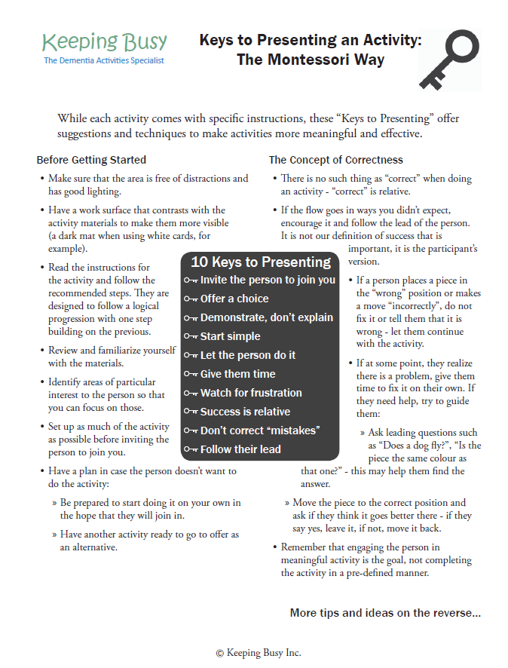
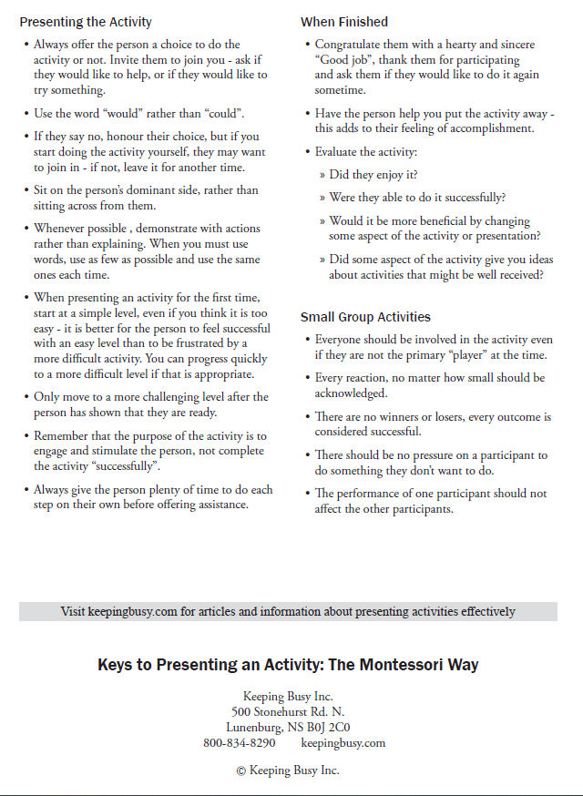
10 Keys to Presenting
Invite the person to join you
Offer a choice
Demonstrate, don’t explain
Start simple
Let the person do it
Give them time
Watch for frustration
Success is relative
Don’t correct “mistakes”
Follow their lead
Notes:
We’ve talked lots about tailoring activities – but how do we present the activity? That will make all the difference in engagement.
This guide is a nice resource from Keeping Busy on how to present an activity – You can find it online or we have a copy of it at our GPCSO booth.
I’d like to discuss their 10 Keys for Presenting Activities:
Invite the person to join us by saying “would you” not “could you”
E.g. Would you like to help me sort these cards?
If we had asked ‘could/can you help me sort these’ they may just say no because they’re not sure if they can and don’t want to fail. But when we phrase it as ‘would you’ its more asking if someone wants to do something not if they can do it.
Offer a choice to the person whether they want to do the activity or not
If the person says no, that’s okay. Sometimes if we just start doing the activity ourselves and they watch for a bit, we may re-invite them, and they’ll then hopefully want to join in.
Demonstrate what we want them to do, not just explaining with words
Start simple
It’s better for a person to feel successful with an easy level than to be frustrated by too difficult of an activity. We can always make the activity more challenging if/when the person is ready
Let the person just do it their way even if it’s not what we’d call ‘right’
Give them time
People with dementia have a slower processing time, so always give the person plenty of time before jumping in to try and offer your assistance.
Watch for signs of frustration that the person needs assistance or the activity should be adapted
Remember that success is relative – They may not have coloured inside the lines, but its still a very successful picture
Don’t correct “mistakes”
Follow their lead – This is from Montessori methods which is all about being self-directed and doing activities based on our natural interests
Note: Montessori is an educational method that involves self-directed learning based on natural interests and activities rather than formal teaching methods.

Slide 32
Notes:
A nice summary from DementiAbility on matching needs to interests and abilities.
If the person’s core need is love and belonging – Can we involve them in groups for social connections, perhaps try doll therapy so the person has someone to care for nurture. Some people will acknowledge that the doll is not real, but it still brings a feeling of comfort to hold the doll or change its outfits.
If the person needs meaning and purpose – Can we assign them jobs, tasks, roles that they can do?
I had a client who run an inn with his wife all their lives and was always busy caring for the property and when he moved into a RH felt very lost and needed a purpose. We got him involved with housekeeping by giving him a duster to walk around with, other days he would sit in the front lobby and press the ‘door open button’ when people arrived at the home.
If the person needs leisure and relaxation, we can create activities that connect to their interests and abilities. Perhaps they love to fish.
Early on in the dementia journey – Perhaps go fishing, if their RH has an aquarium they can help feed and identify the fish inside, untangle ropes
In the middle stages – Maybe they can wind ropes, sort pictures of fish, sort and organize a tackle box (no hooks – but sort the lures by colour)
In the late stages – Watch a fishing show, listen to sounds of the lake, eat fish for dinner
If there is interest in learning – What would this person like to learn about?
If the need is for independence, what memory supports can we put in place? For example, someone may struggle to get dressed because of sequencing problems but if we set their clothes out for them one at a time or in the order to be put on, it supports that independence of being able to do it by oneself.
We want to consider the whole person – Body, Mind, Spirit

Slide 33
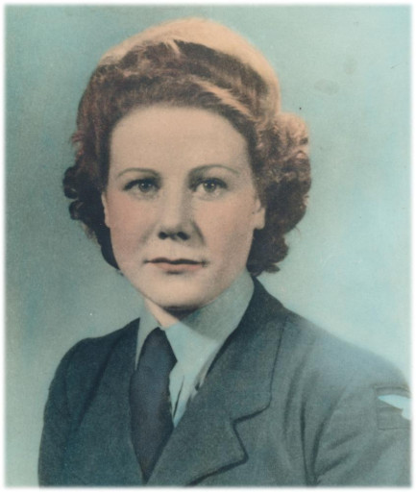
Interactive Group Application
Tailoring Activities for Mary
Notes:
We’re now going to move into some interactive group work so you can practice applying everything we’ve just talked about and brainstorm some activity ideas that are tailored to an individual’s needs, interests, abilities.
I’m going to introduce you to Mary.

Slide 34
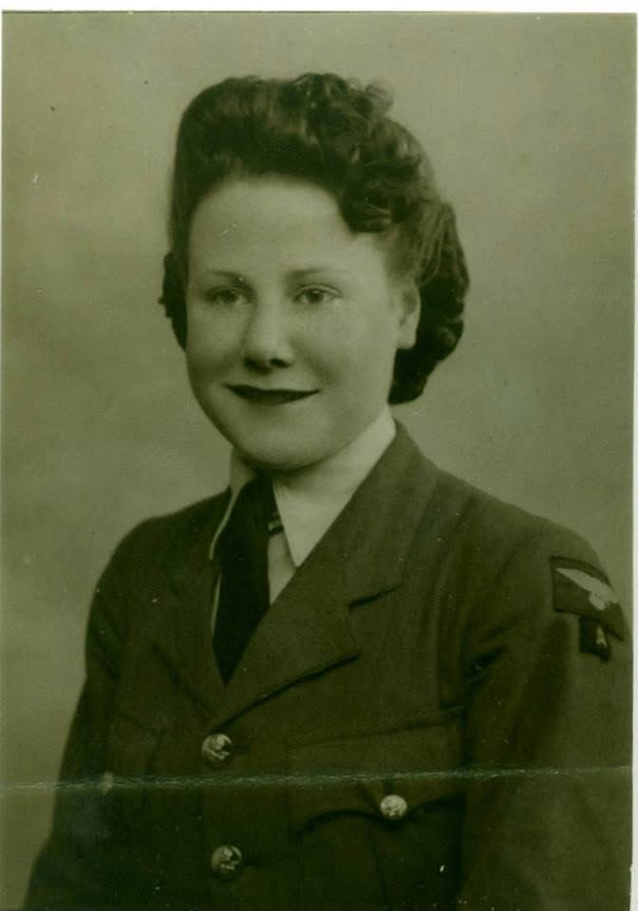
Interactive Application – Case Study
Mary
Grew up in a small town in England with two brothers
Joined the British Women’s Auxiliary Air Force
Married Roy, a Canadian soldier, and moved to Canada
Settled in Petawawa and became a stay-at-home mom of seven children
Catholic and attends mass every Sunday
Best baker – Known for her buns
Volunteered her time at animal shelters & always had a dog for a family pet
Enjoys Gospel music, gardening, doing puzzles, watching the birds
Notes:
Mary was born in a small town in England and was raised with two brothers.
She joined the British women’s auxiliary air force and is a world war 2 veteran – This is a lovely photo of her in uniform.
As the war ended in 1945, she met Roy, a Canadian soldier at a train station and they fell in love.
They married and Mary moved to Canada settling in Petawawa. Roy continued to work on base and Mary became a stay-at-home caring for seven children.
She is a proud Catholic, attending mass regularly and enjoys Gospel music
She is a fantastic baker & known for her buns – Brings them to church bAZARS
She is an animal lover – Volunteered with animal shelters, always had a family dog
She’s very much an outdoors woman – Likes to walk, garden, and loves birds – she’s the queen of bird feeders

Slide 35
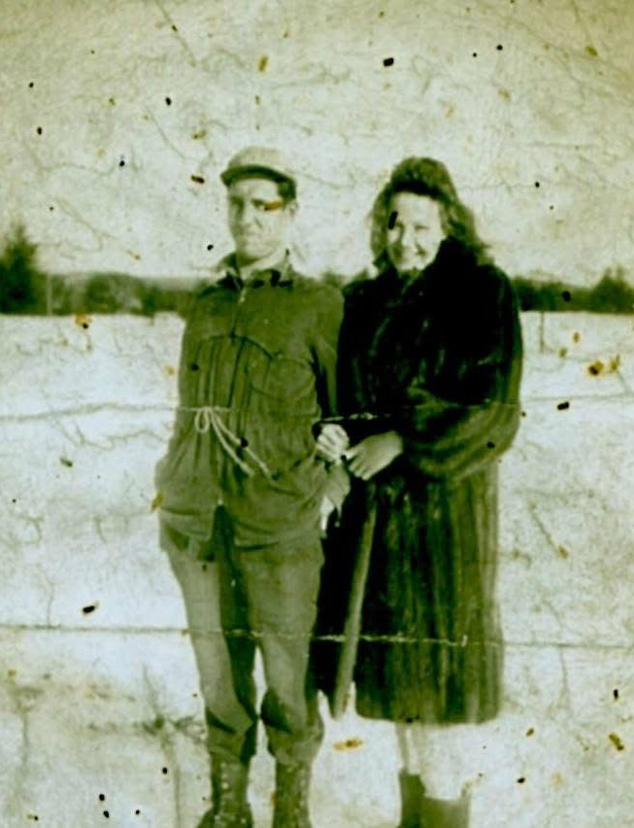
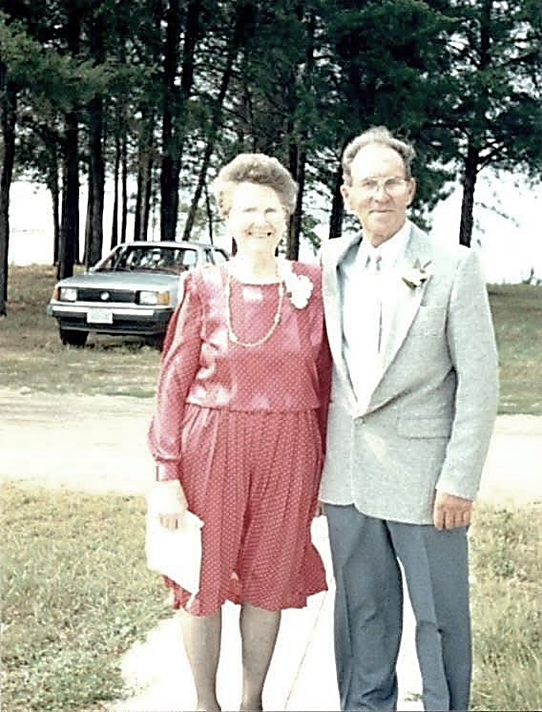
Interactive Application – Case Study
Cared for her husband at home until he died from lung cancer
Family noticed signs of early dementia
Notes:
Here’s a nice look at Roy and Mary over the years together.
Mary cared for Roy at home as he battled lung cancer, and he eventually passed at the age of 87.
After his death, family were noticing signs of early dementia in Mary …

Slide 36
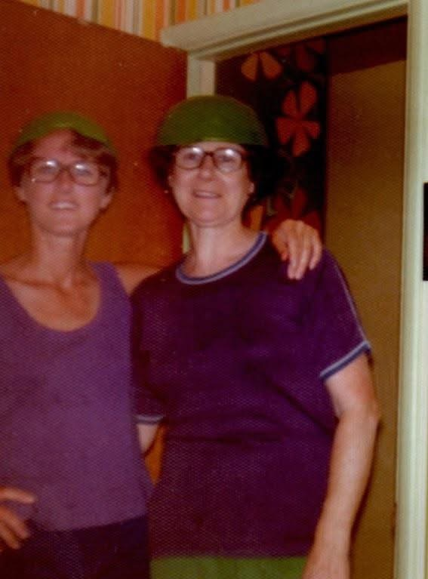
Interactive Application – Case Study
Moved in with one of her daughters for a year
As dementia progressed, moved into LTC in Pembroke
Notes:
Mary moved in with one of her daughters for about a year, the photo on the left here is Mary with that daughter.
As her dementia progressed into the moderate stages her daughter was no longer able to care for her at home and so she moved into a LTC home here in Pembroke.

Slide 37
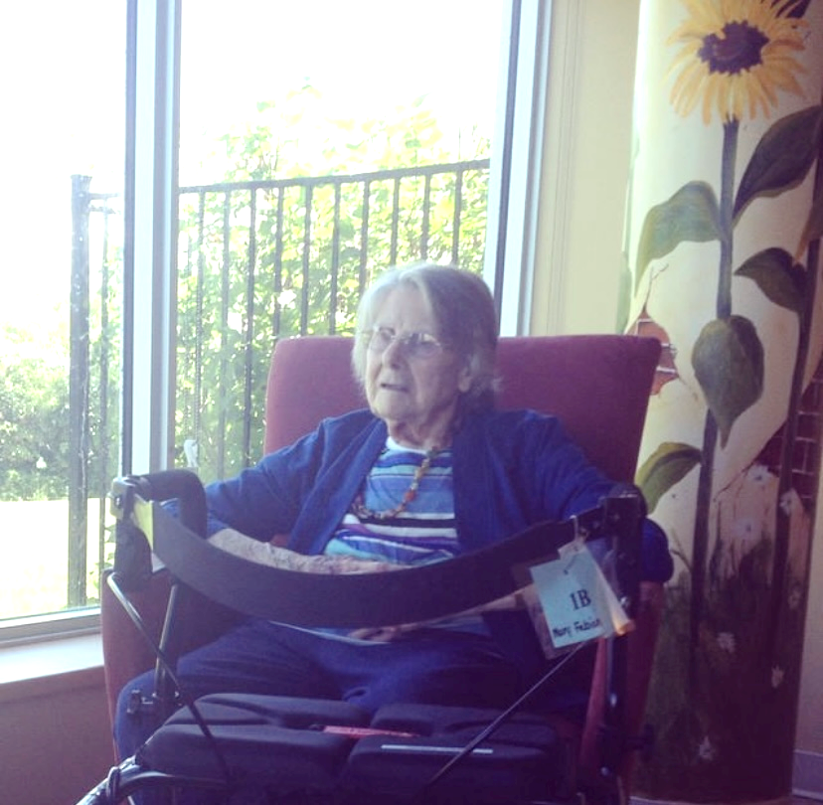
Interactive Application – Case Study
Current Findings
Spends most mornings snoozing in her recliner
Spends most afternoons wandering the unit
Will occasionally enter other resident’s rooms
When bored or lonely starts to appear anxious and fidgets
Current Abilities:
Requires glasses for distance and reading
Transfers & walks independently with walker
Eats independently – Needs assistance with other ADLs
Mary has the physical ability to do most things, but cognitively forgets steps or doesn’t remember to do the task at all
Responds well to cueing
Notes:
This is a look at the lovely Mary aged 90 with her walker in LTC.
She tends to spend most of her time in the morning snoozing in her recliner & spends most afternoons wandering the unit. She’ll occasionally enter other peoples’ rooms but doesn’t cause problems
When she’s bored or lonely she wanders more, looks anxious, and is very fidgety.
In considering her current abilities, she needs glasses, she needs a walker but can transfer and mobilize independently. She also eats independently, but needs assistance with grooming, bathing, dressing, toileting.
Mary has the physical ability to do most things but cognitively forgets steps or doesn’t remember to do the task at all. But she responds really well to cueing

Slide 38
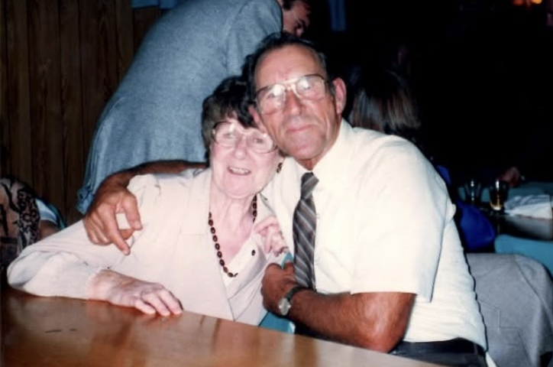
Interactive Application – Groups
Group 1 | Group 2
Create ten activities for Mary based on her needs, interests, skills, abilities | Adapt the LTCHs five pre-planned activities to meet varying abilities Exercise Class Art Class Gardening BINGO Puzzles
Mary & Roy
Married for 66 years
Notes:
We’re going to divide off into two groups
Using information from Mary’s case …
Group 1 is going to plan ten activities for Mary taking into consideration her needs, interests, skills, abilities
Group 2 will take the five core activities that the LTCHs recreation department has planned and brainstorm ways that we could adapt that activity for changing needs.
I have paper handouts that I’ll give to everyone once you’re in your groups.
You’ll have about 15? Minutes to work on this, have someone in your group make notes, and then each group will have about 5 minutes to share what they came up with.

Slide 39
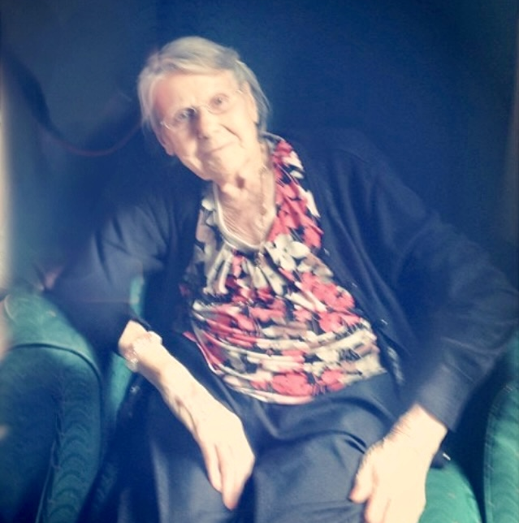
Interactive Application – Thank You
Mary
(1922 – 2014)
Notes:
You have all done an amazing job creating activities for Mary that meet her needs, suit her abilities, and really take her personhood into account.
And we’ve discussed lots of ways that activities can be adapted for individuals to continue to enjoy as their dementia progresses and their abilities change.
So, as Mary’s great-granddaughter, I want to thank you all for the amazing work you do for people in your care like Mary. I really appreciate it.

Slide 40
Thank you!
Kaitlyn Borutskie, BScN, RN
Psychogeriatric Resource Consultant (PRC)
kborutskie@bruyere.org
613-562-9777 x5255
Geriatric Psychiatry Community Services of Ottawa
Notes:
Thank you all for your time this afternoon.

Slide 41
References
Title
Alzheimer’s Society. (2017). Person-Centered Language Guidelines. [PDF]. https://alzheimer.ca/sites/default/files/documents/Person-centred-language-guidelines_Alzheimer-Society.pdf
Bolby Sifton et al. (2011). Living with Alzheimer’s Disease and Related Dementias: A Manual of Resources, References, and Information. CAOT Publications, 192p.
Keeping Busy (2014-2024). https://keepingbusy.com/
Reisberg, B. (1988) Functional Assessment Staging (FAST). Psychopharmacology Bulletin. 24:653- 659. *FAST available online in English: http://www.mccare.com/pdf/fast.pdf
Warchol, K., Copeland, C., and Ebell, C. (2002). Activity Planning Book: How to Provide a Therapeutic ADL and Leisure Activity Program for Persons with Dementia. Dementia Care Specialists, Inc.

