Slide 1

Self-Compassion
for the Healthcare Community

Slide 2
Robert Wicks: The Necessity of Self-Care (video)
https://youtu.be/jvENAkUo9YQ?si=yFTo_Rg5Dx6K17sT

Slide 3


Objectives
01
02
03
Learn the three skills of self-compassion.
Practice experiential self-compassion activities and exercises.
Reflect about how you might implement some brief self-compassion practices in your daily life.

Slide 4
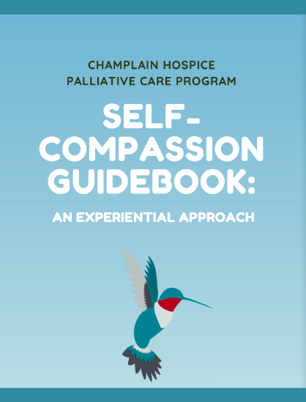
Electronic version
available free at
www.champlainpalliative.ca
Under the “Self-Care for Healthcare Workers” tab.

Slide 5
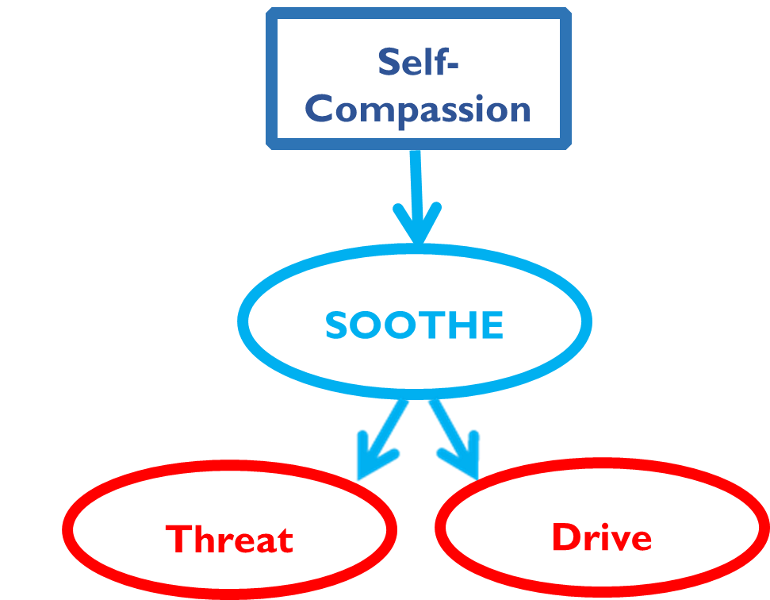
Self-compassion can activate our soothe system, which calms our threat system and our drive system.

Slide 6
Self- Compassion is a Skill (video)
https://youtu.be/nWF9ZJ35PrU?si=SM2d4ehcNvVyvq2f

Slide 7
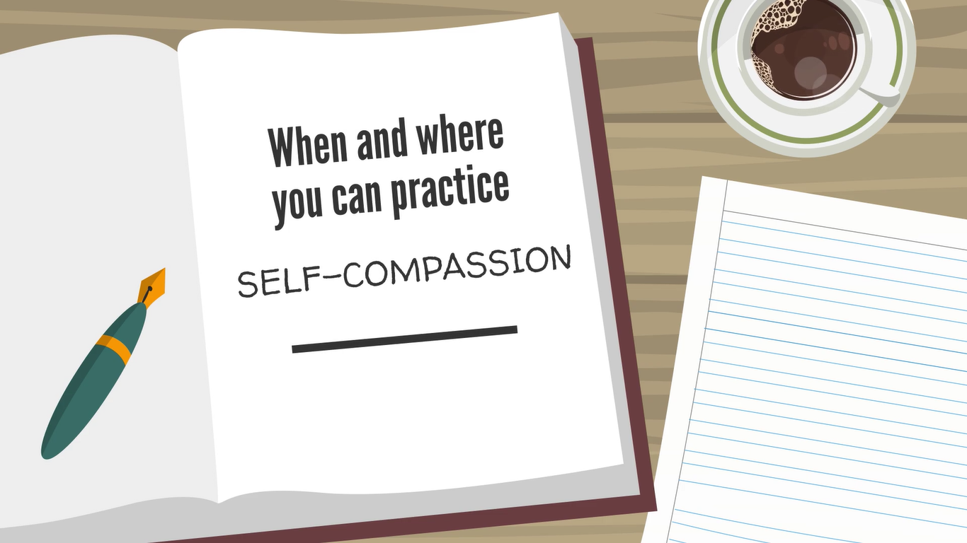

Writing Activity

Slide 8

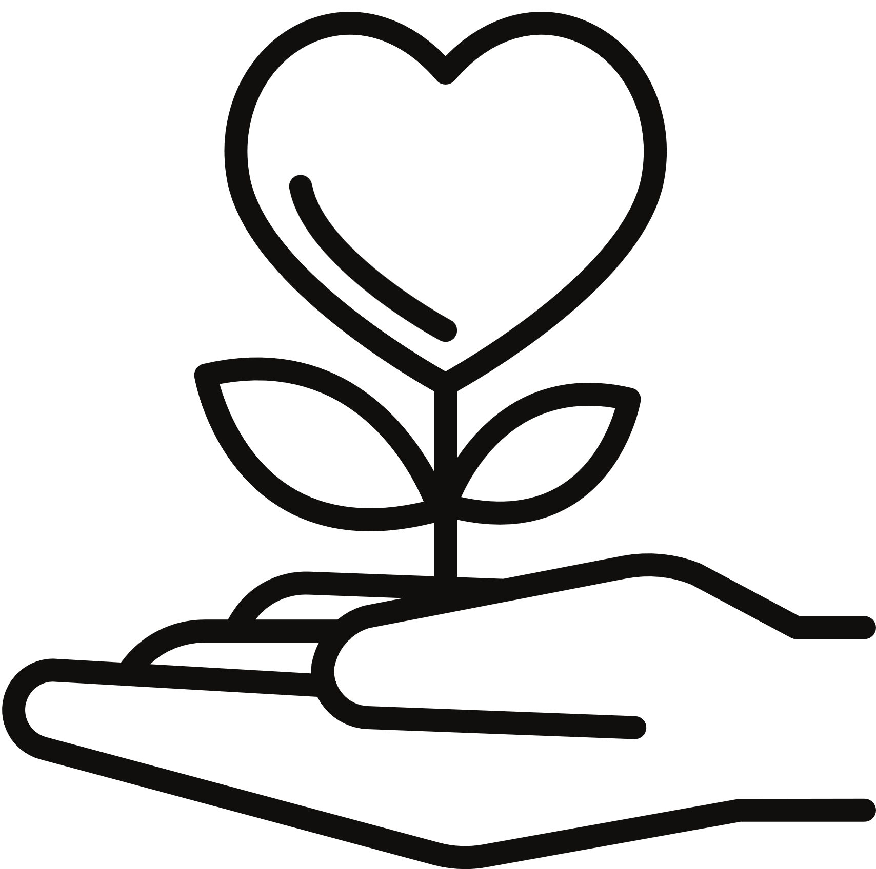

Self-Compassion
Comprised of 3 Key Skills
Noticing
Self-kindness
Common Humanity
Neff, K. (2011).

Slide 9

These exercises might really work for you and they might not.
Let’s stay open and see what happens.
-Michele Chaban

Slide 10
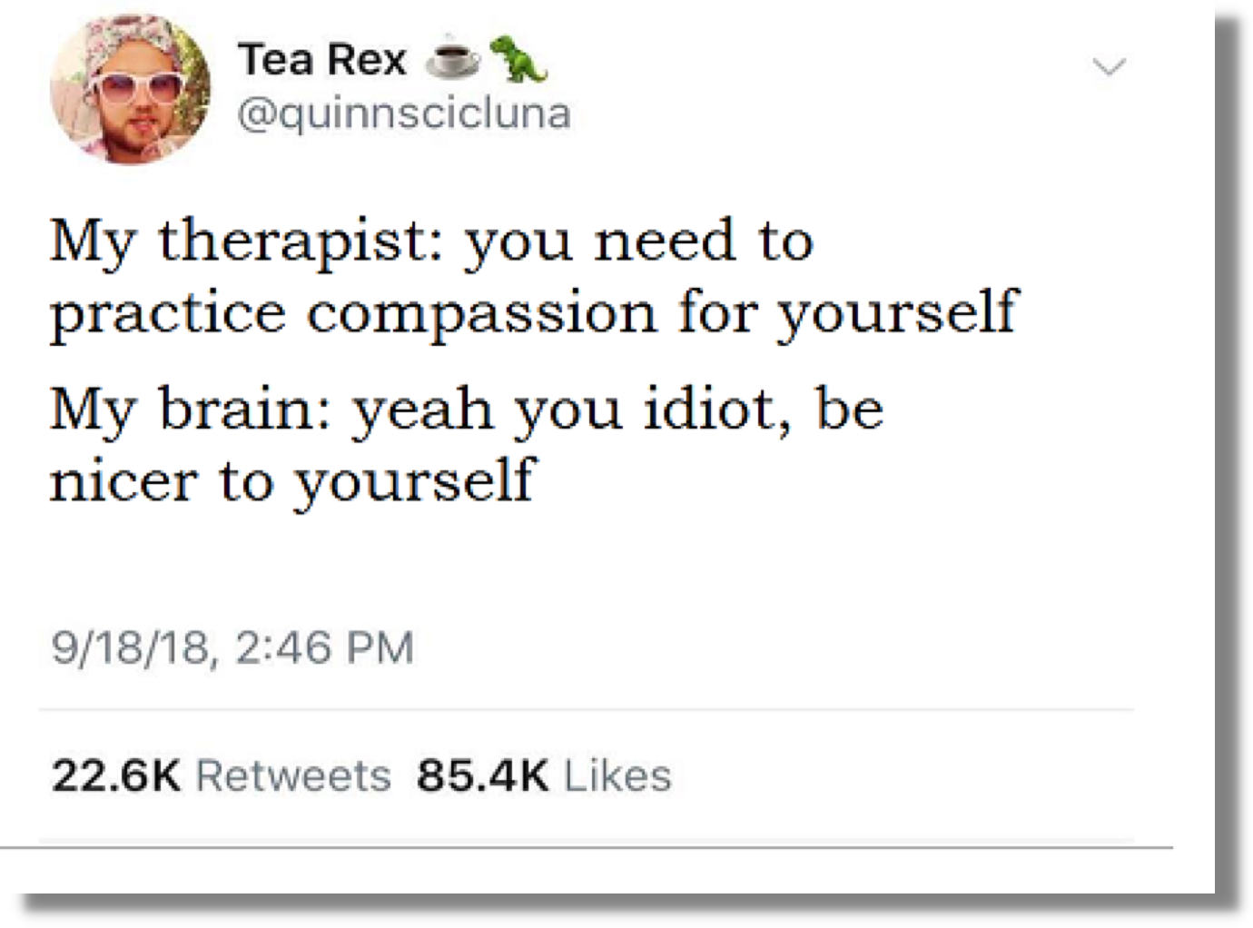

Slide 11
Skill 1: Noticing
The ability to notice what you’re experiencing
and when you need to take care of yourself.
Neff, K. (2011).

Slide 12
Early Signs that you are Struggling(video)
https://youtu.be/4lu1JXUmyIY?si=DLN2kyB3_x1otUAj

Slide 13







JUST WANTING THE DAY TO BE OVER ALREADY
DESPERATELY NEEDING A NAP
Some early signs
you may be
struggling
EATING ONE TOO MANY CUPCAKES
HAVING A FEW TOO MANY BEERS OR GLASSES OF WINE AFTER WORK
NOT GOING OUT WITH FRIENDS
WATCHING NETFLIX FOR 5 HOURS STRAIGHT

Slide 14
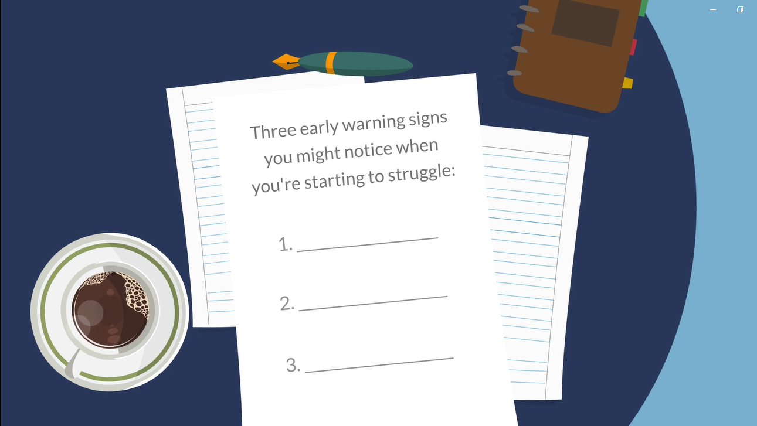

Slide 15

Noticing
Exercise

Slide 16
Skill 2: Self-Kindness
Being kind and gentle to ourselves,
particularly when we have problems.
(Neff, 2011)

Slide 17

"So many of us carry around a long list of worthiness prerequisites:"
“I’ll be worthy when I lose twenty pounds.”
Feeling worthy of treating yourself with kindness.
“I’ll be worthy when I get promoted.”
“I’ll be worthy if other people think I’m a good parent”
“I’ll be worthy if I can do it all and still look like I’m not trying.”
(Brown, 2010, p. 23-25)

Slide 18
The greatest challenge for most of us is believing that we are worthy right now, in this minute.
-Brené Brown

Slide 19
DON’T WAIT!
-Frank Ostaseski

Slide 20
Hands on Heart
Activity
• Put one or both of your hands over your heart
• Take deep breathes
• Gently say something to yourself that you need,
like, “May I be happy. May I be at peace.”

Slide 21
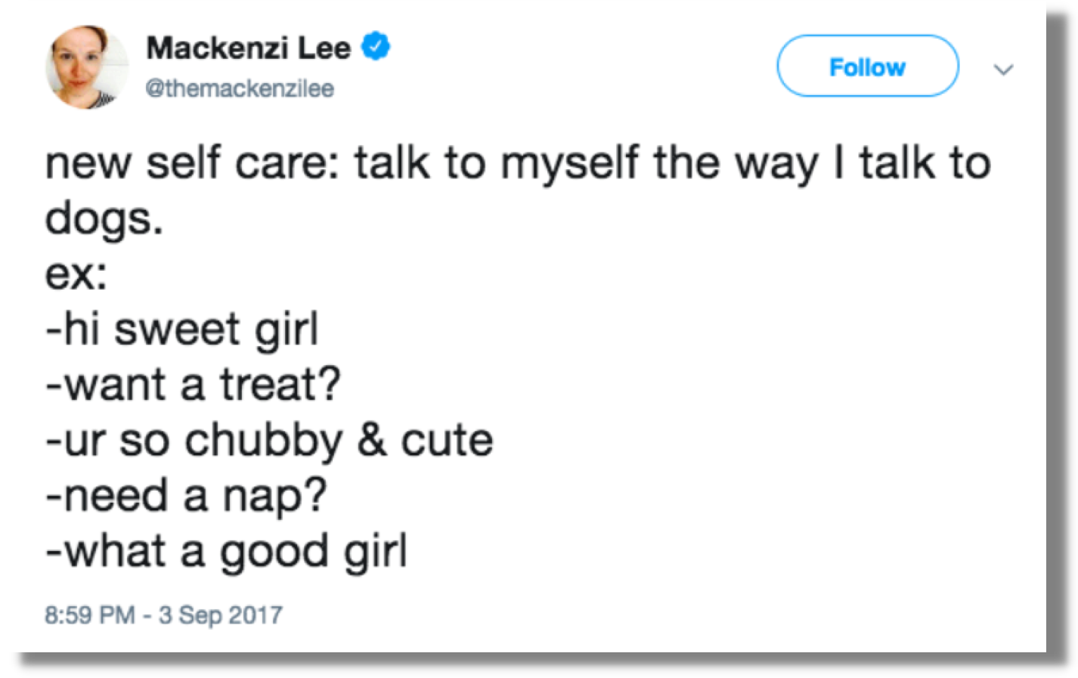

Slide 22
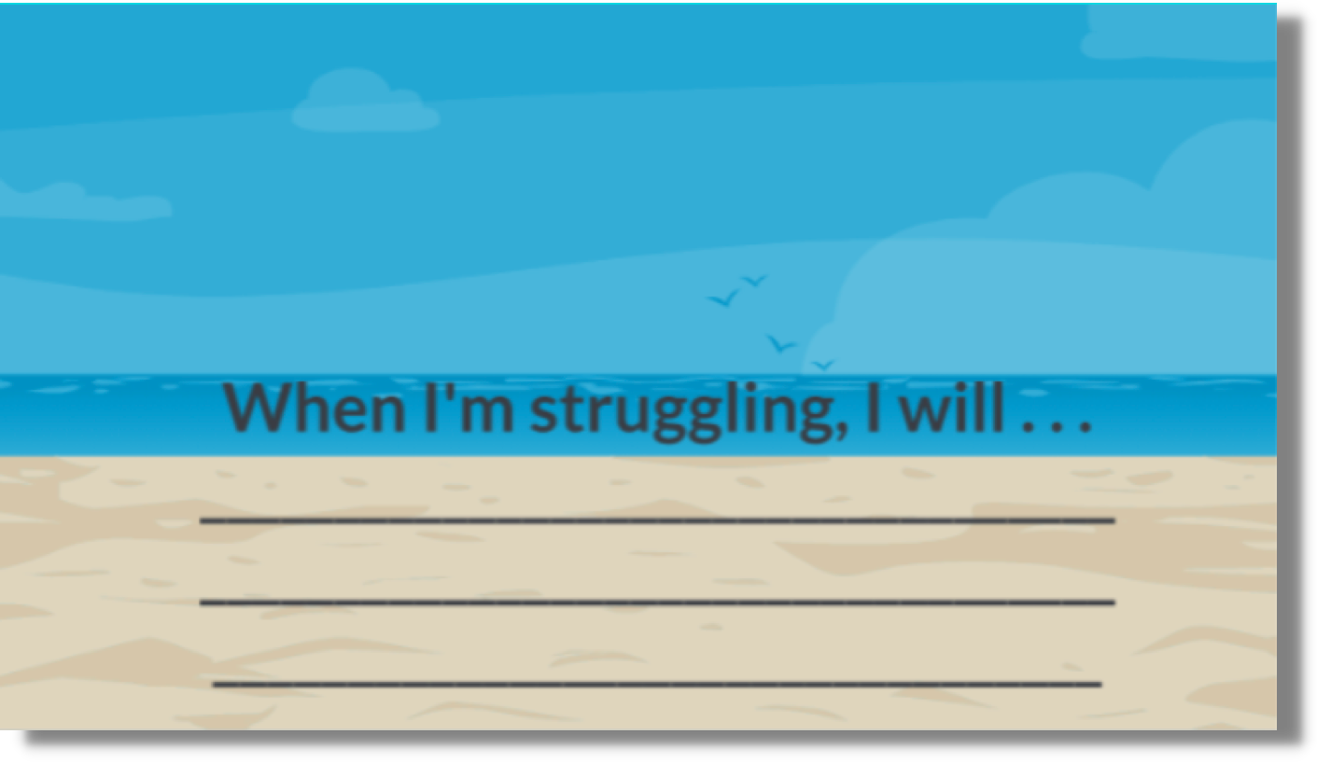
Six-Word Self-Kindness Story

Slide 23
Skill 3: Common Humanity
Recognizing that struggling is a shared human experience.
We are not alone in our problems. We are in this together.
(Neff, 2011)

Slide 24

An old Currajong Tree , New South Wales. Marianne North.

Slide 25
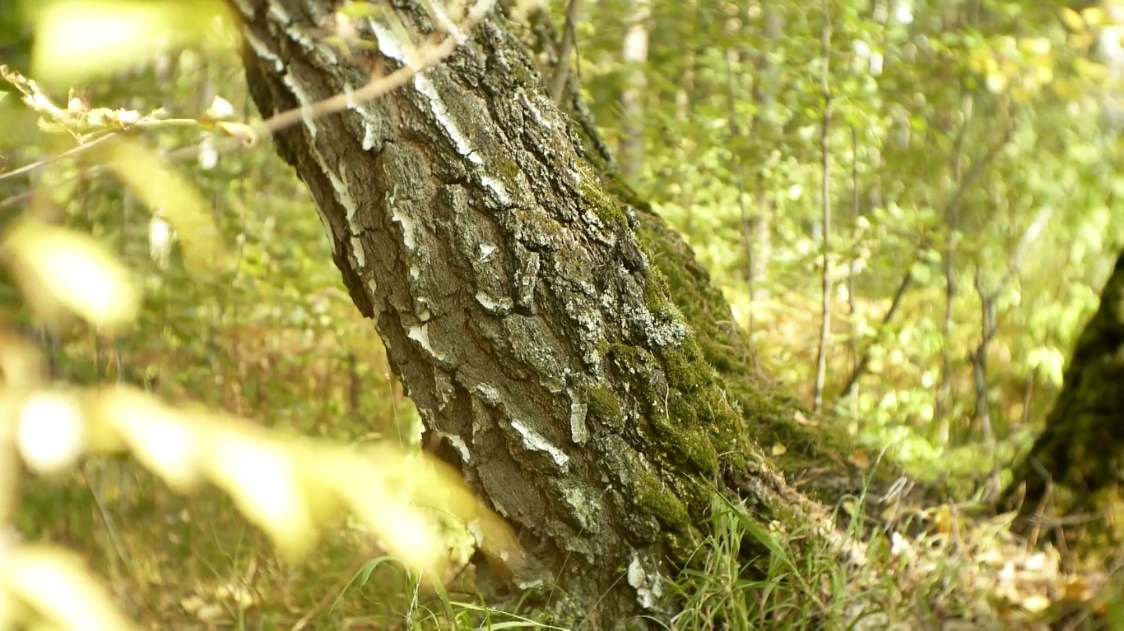

Slide 26
Common humanity involves the recognition that we are all like gnarled, crooked trees.
We all have losses
We all have regrets
We all have imperfections
(Brown, 2010, p. 23-25; Neff, 2011)

Slide 27
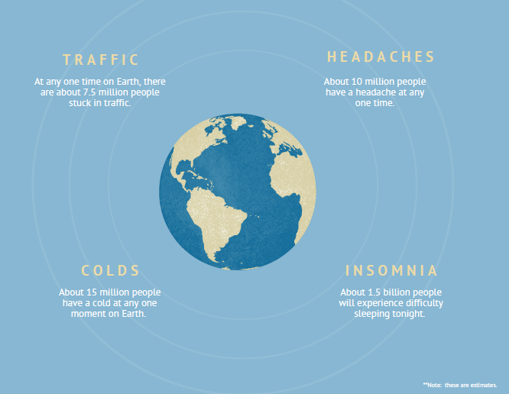

Slide 28

Circle of care exercise
(Bush, 2015, p. 38)

Slide 29
Call to Action:
Self-Compassion Plan

Slide 30





Self-Compassion Plan
Noticing
Write down a simple way you can bring noticing into your daily life.
Self-Kindness
Write down a simple way you can bring self-kindness into your daily life.
Common Humanity
Write down a simple way you can bring common humanity into your daily life.

Slide 31
References
Brahm, A. [urbanbuddhistmonk]. (2014). Ajahn Brahm – Why practice self compassion October 17, 2014 [Video file]. Retrieved from https://www.youtube.com/watch?v=UrIgvyRNlts
Brown, B. (2010). The gifts of imperfection: Let go of who you think you’re supposed to be and embrace who you are. Center City, MN: Hazelden.
Bush, A. (2015). Simple self-care for therapists. W.W. Norton & Company, New York, NY.
Center for Clinical Interventions. Retrieved from https://www.cci.health.wa.gov.au/~/media/CCI/Mental-Health-Professionals/Self-Compassion/Information-Sheets/Info-What-is-Self-Compassion.pdf
Neff, K. (2011). Self-compassion: The proven power of being kind to yourself.
Neff, K., & Germer, C. (2018). The mindful self-compassion workbook: A proven way to accept yourself, build inner
strength, and thrive. New York, NY: The Guilford Press.

