Slide 1

Supporting People with Dementia through Advance Care Planning,
Goals of Care,
and Health Care Consent in Ontario
Notes:
Add CDN logo in place of one of these.

Slide 2



Objectives
Understand Advance Care Planning (ACP), Goals of Care (GOC), and Health Care Consent (HCC) in Ontario
Know how to confirm a
Substitute Decision Maker(s)
(SDMs)
Having the right conversation at the right time with the right people
Notes:
The words we use are very important to create shared understanding and meaning. Many of these terms are borrowed from other jurisdictions and provinces – when we use some of them in Ontario it can create confusion.
If you have time, ask the audience what they understand about each term to demonstrate how it can be used/interpreted differently by different people.
There is a need to get on the same page with the language we use.
Additional Information: (general knowledge - not needed for presentation)

Slide 3



Some day, we will all die Snoopy!
True, but on all
the other days,
we will not.
Notes:
Yes, one day we will die but on all the other days we will not. Advance Care Planning is about all of those other days: what is truly important to you in your life? What do you value? How do you wish to live your life?
Many people aren't aware of Advance Care Planning or think it doesn't apply to them. The truth is, advance care planning is for everyone. It is recognizing that life is unpredictable, and if you were ever in a situation where you could not make health care decisions for yourself, you would need a Substitute Decision Maker to speak on your behalf. You can have conversations in advance, with your substitute decision maker, so if they ever needed to make decisions for you, they would know how you want to live.

Slide 4
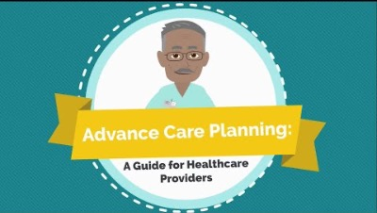

Slide 5
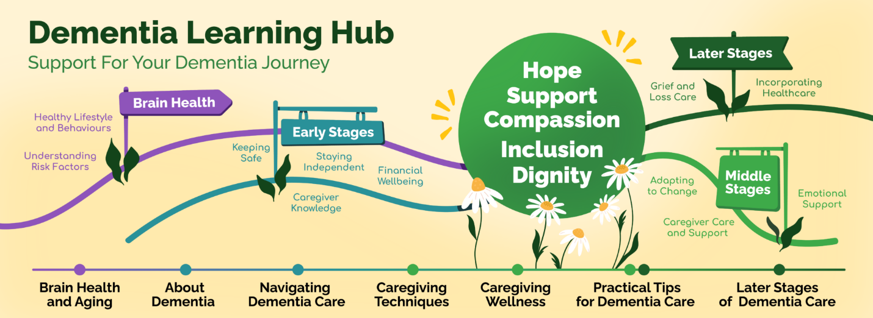
Dementia Journey Infographic
Notes:
Add infographic

Slide 6



Terminology
Advance Care
Planning
Goals of Care
Capacity and Informed
Consent
Notes:
The words we use are very important to create shared understanding and meaning. Many of these terms are borrowed from other jurisdictions and provinces – when we use some of them in Ontario it can create confusion.
If you have time, ask the audience what they understand about each term to demonstrate how it can be used/interpreted differently by different people.
There is a need to get on the same page with the language we use.
Additional Information: (general knowledge - not needed for presentation)

Slide 7

Clarifying Confusing
Terminology
Not aligned well with
Ontario law
Well aligned with
Ontario law
  Advance Care Plan
  Advance Directives
  Living Will
  Personal Directive
  Advance Care Planning
  Health Care Consent
  Power of Attorney
  Goals of Care

Slide 8
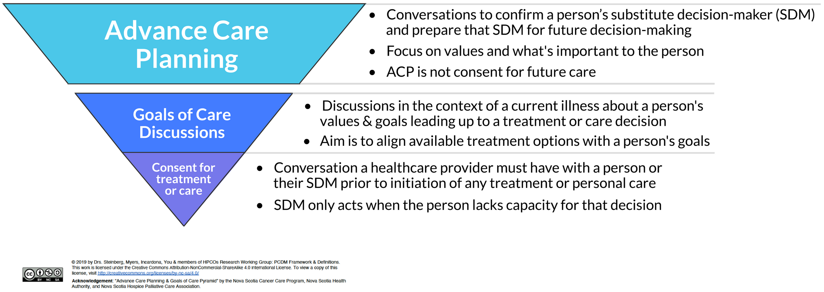
Terms in Ontario

Slide 9
Why is ACP Important
ACP is a way to help prepare for future health and personal care needs by:
  Identifying a substitute decision-maker
  Thinking about priorities and values about health and well-being
ACP helps a substitute decision maker learn more about a person’s values and priorities in case they need to make decisions for them in the future
ACP prepares a SDM(s) to give consent for treatments in the future, if a person is NOT mentally capable.
ACP conversations today will make it easier for a SDM(s) in the future so they don’t have to guess at an individual’s wishes in the middle of a difficult time.
ACP can decrease the burden and stress experienced by a SDM.

Slide 10
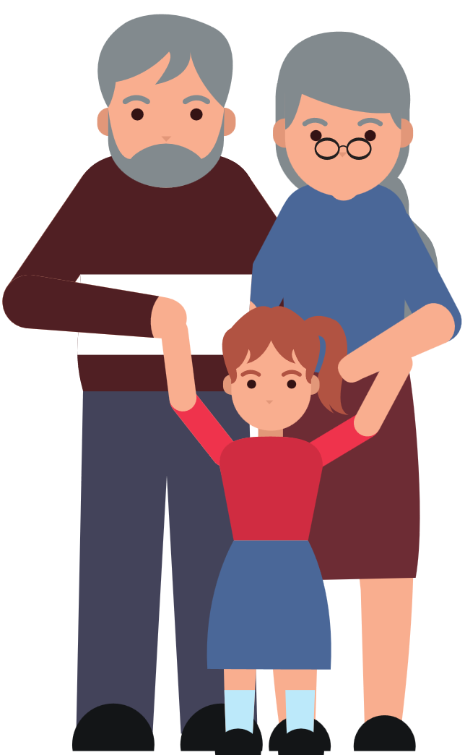


Advance Care Planning
There are two important parts
to ACP in Ontario:
Confirm your substitute decision maker(s)
Have conversations about what is important to you
Notes:
In Ontario, Advance Care Planning is:
Identifying who your substitute decision maker is – the person or people who will make your health care decisions for you in the event you are mentally incapable of making them for yourself and,
Having conversations with them, and your other loved ones, about what is important to you
And both of these things should happen long before there is a crisis.

Slide 11
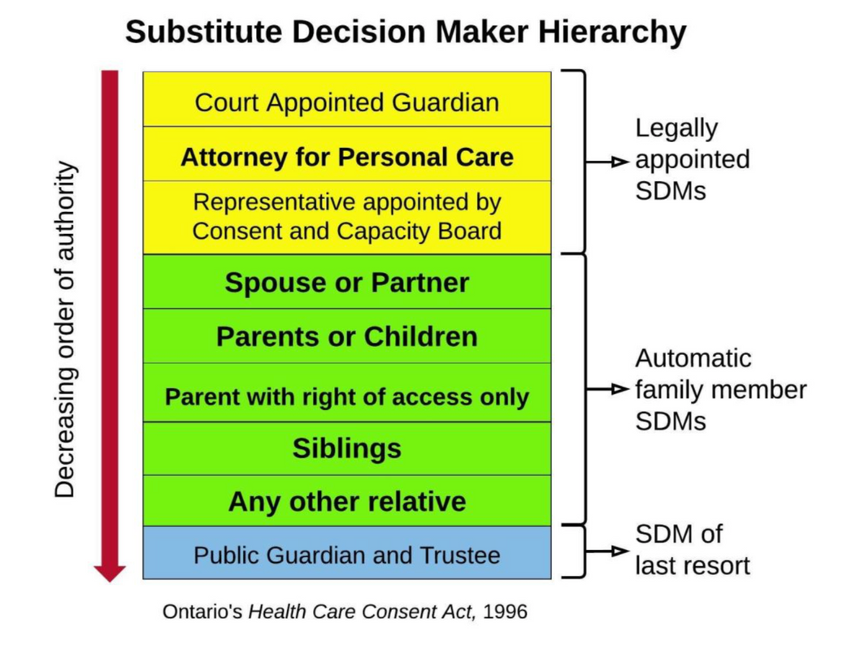
SDM Hierarchy
By default, your SDM(s) will
be the person or people highest
ranked on the hierarchy who meet
the criteria to be a SDM
Notes:
These notes below are not meant to be read verbatim but it is a resource for you as the facilitator to be able to explain in detail.
The Ontario Health Care Consent Act, includes a hierarchy that provides every person in Ontario with an automatic SDM(s). Even if you have never done a Power of Attorney for Personal Care.
The person(s) that are the highest ranked in this hierarchy and that meet the requirements to act as an SDM(s) will be appointed as such
For example, if I end up in hospital today and I am incapable, the health care providers must figure out who my highest-ranking Substitute Decision Maker is. They must start at the top of this list and make their way down until they find the right person(s)
People often get questions about how they know who their SDM will be. One answer is that we have created a wallet card (show them the card) that we encourage people to complete and carry in their wallet so that health care providers can use it as a starting point. Important to note that it is NOT a legal document. It is just to help them start in the right direction.
As you can see, the first three in yellow are Legally Appointed SDMs. Someone actually has to DO something in order to be appointed as an SDM or to appoint an SDM.
Guardian of the person: This is someone that is appointed by the court to be your SDM. This is a very rare circumstance that is lengthy and expensive. If you have not gone through a lengthy court process to get guardianship over another person, this level does not apply. In essence, you would know if you have done this. An example of this in case people ask is: imagine two siblings are SDMs for their mother. If they cannot get along and agree on decisions for their mother, and one believes that the other is not acting in their mother’s best interest, one (or both) could apply to be her Guardian. They have to hire a lawyer and make a case as to why they should be the SDM over their sibling.
Power of Attorney for Personal Care: This

Slide 12

Requirements to Act as an SDM
  Mentally capable with respect to treatment proposed
  At least 16 years of age
  No court order or separation agreement prohibiting access to the incapable person or giving or refusing confront on their behalf
  Must be available
  Willing to assume responsibility of giving or refusing consent

Slide 13




Qualities of a good SDM
Honours wishes and instructions, even if they differ from your own
Is guided by your most recently expressed values, wishes, and beliefs
Can be a strong advocate
Is calm in a crisis and able to handle conflict

Slide 14
Who acts as SDM?
Scenario 1
Bob is 75 and has had a heart attack and is in a coma. He is a widow and has 4 adult children –
    Jane lives with Bob
    Terry lives an hour away
    Mark lives in B.C.
    James lives in England
The doctor has recommended Bob have bypass surgery and needs consent. Who provides the doctor with informed consent for treatment?

Slide 15
Who acts as SDM?
Scenario 2
Marie is 85 years old and a Long-Term Care bed has become available for her.
The Care coordinator does not think Marie has the capacity to make her own decision about moving into LTC.
The coordinator turns to her SDMs to obtain informed consent to admit her to LTC.
Marie’s two adult children are her automatic SDMs according to the hierarchy.
They cannot agree on the decision. One says yes and the other says no
What happens in this case?

Slide 16
Who acts as SDM?
Scenario 3
Don is 54-year-old man who has been separated from his wife for over 2 years and has no children. He is close with his aunt and uncle who are healthy and in their 70s and helped raise him, and with his 49-year-old cousin Trevor with whom he has discussed a Power of Attorney, but it was never done.
During a routine surgery, there is a complication and Don is now in a coma. Who should make decisions about his treatment plan?

Slide 17


Informed Health Care Consent
Prior to any healthcare decisions, a health care provider must obtain informed consent from a mentally capable person to start treatment.
Consent can be obtained from either the patient OR substitute decision maker(s) if the patient is incapable
The only exception to a healthcare provider requiring consent
is in the case of a medical emergency
Notes:
So to put Health Care Consent and Advance Care Planning into context… (first point), before, …(second point), providing any treatment ….(third point)
Note following point: Many people believe that Health Care Providers can decide what treatments to give you; however, in Ontario, this is not the case. Health care providers MUST get consent (permission) before providing any treatment.
This includes small things such as changing Advil to Tylenol, to big things like open heart surgery. Consent is always needed. The ONLY exception when a health care provider does not need to get consent is if it is an emergency. This means that there is a large risk of death or serious injury. But, once the person is stabilized, they then have to begin getting consent. Either from the patient, if they are mentally capable, or from their Substitute Decision Maker.

Slide 18


Slide 19
Capacity
For a client to be considered capable of making a specific decision, they must be able to:
Understand the relevant information
Appreciate the reasonably foreseeable consequences of action or inaction
* Capacity is time-dependent and decision specific.
* Capacity is not based on a score on a mental status exam or other test or a diagnosis.

Slide 20
Incapable Person’s Rights
Must be informed that an SDM has been appointed to make their decisions
Reserve the right to appeal the appointment of an SDM or findings of incapacity to the Consent and Capacity Board (CCB). If needed , they must be assisted in appealing to the CCB.

Slide 21
Applying to the CCB
A client applies to:
Challenge finding of incapacity (Form A)
Dispute or change appointment of an SDM (Form B)
An SDM applies to:
Clarify the applicability of previously expressed wishes (Form D)
Depart from previously expressed wishes (Form E)
A health practitioner applies to:
Review if an SDM is complying with their responsibilities (Form G)

Slide 22
CCB Process
1. Apply to the Board
2. Schedule a hearing
3. Hold a hearing
4. A decision is made
The CCB is an independent body of provincial government.
Each party may attend the hearing and invite anyone they want to come. Hearings must be held within 7 days of request.
Each party may have a lawyer, call witnesses and bring documents. Each party and the Board members will ask questions of each witness.
The Board will meet in private to make its decision which will be issued within one day. Any of the parties may appeal the Board’s decision to the Superior Court of Justice.

Slide 23
SDM Conflicts
When an SDM is not acting in the best interests of an incapable person
an application can be filed to the Consent and Capacity Board
When SDMs cannot agree on treatment options
The Public Guardian and Trustee may be asked to decide instead

Slide 24
Best Interest Standard
Applied when there are no known prior wishes
What are the person’s known values and beliefs?
Will treatment improve the condition, prevent deterioration, or reduce the extent/rate of deterioration from the condition?
Would the person’s condition improve, stay the same, or worsen if the treatment was not administered?
Do the benefits outweigh the risks?
Is there a less intrusive/invasive treatment that provides the same benefit?
Once these have been fairly considered, an SDM can be confident that they are acting in the best interest of the person.

Slide 25
Goals of Care Conversations
Goals of care discussions are needed to support people with serious illness when they face treatment and/or care decisions.

Slide 26
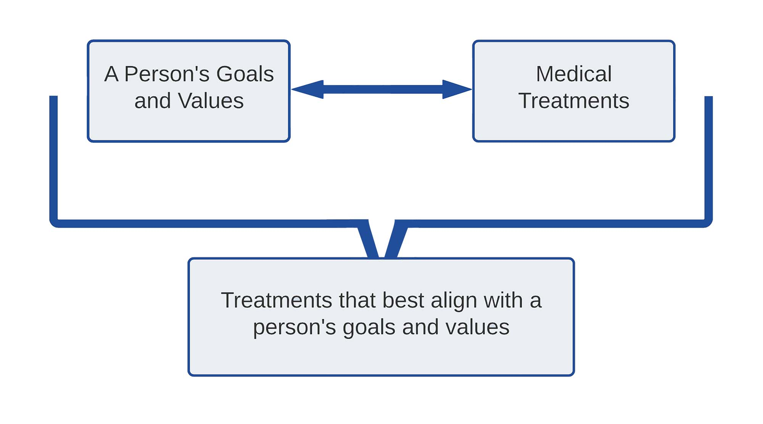
Goals of Care Conversations
Source:https://www.pcdm.ca/goc#gocdimportant
Notes:
Why are goals of care discussions challenging?
Clinicians often say they:
lack training to support people through what often are emotional conversations
worry about removing hope or causing distress
worry about managing uncertainty, especially about prognosis
do not feel they have time required for these discussions
We also know:
it is hard to witness suffering and these conversations often involve difficult choices
clinicians feel that they have failed if they don't have treatments to reverse or treat an illness
But with knowledge and skill, these conversations will allow you to make recommendations and plans that best align with your patient's goals and values.
With skill, you will also learn to support your patients when if their goals are not medically achievable.

Slide 27
Goals of Care Conversations
For example, consider a chemotherapy treatment that:
May give someone more time (months)
Requires visits to hospital and treatment
Will cause fatigue and some other side effects.
Person A:
This person's goals include spending as much time at home as possible and avoiding time in hospital and away from family. His goals don't include adding additional quantity of time. His worries include: worsening fatigued and worsening nausea. These symptoms make it hard for him to spend quality time with his family.
Based on these values and goals, Person B is likely to decide against chemotherapy
Person B:
For Person B her goals include living until her son graduates in a few months. She wishes to have any treatment that might add enough time.
Based on her goals, she may decide to accept chemotherapy if it has a chance of meeting that goal.

Slide 28
Goals of Care Conversations
It is the same illness, the same illness trajectory and the same treatment options.
Person A has different goals and values from person B and that will result in different plans for treatment.

Slide 29
Document GoC Discussions
Documentation of a goals of care discussion helps ensure clarity and consistent care.
Even partial discussions can and should be documented. Other clinicians can pick up and continue the conversation if it is well documented.
Document in the patient's own words as much as possible.
There are four components to document.
Illness understanding
Information given
Goals/values
Treatment recommendations

Slide 30
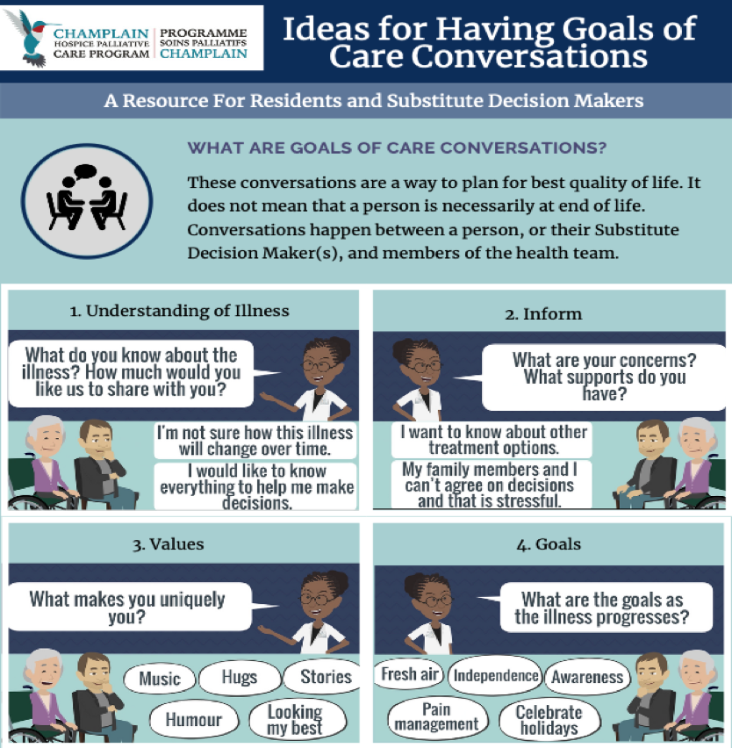
Notes:
Key points:
1. This slide describes the content/type of information that can be shared in goals of care conversations (that happen in the context of a specific illness(es) ) to ensure they lead to a person’s QOL.
2. Goals of care conversations take place regularly in LTC between the individual, their SDM and the health care team.
3. Look at comic strip and read out some of what is gained in having this conversation…

Slide 31
Goals of Care Conversations
See handout

Slide 32
Case Study: Incapacity in the Community
Sarah has dementia and also diabetes.
During her appointment with a GP, Sarah indicates that she has stopped taking her diabetes medication since she feels fine and doesn’t see the point anymore.
Sarah’s GP is concerned about this decision and provides more information about the purpose of the medication and the risks of stopping it. However, Sarah seems unable to repeat the information back or appreciate the impact of her choice on her future.
The GP is unsure about Sarah’s capacity to make this decision and believes that an SDM may be helpful. Sarah is estranged from her family and her SDM would have to be the PG&T.
However, even if the PG&T intervenes and consents, Sarah’s GP is unsure how to enforce the decision – should she be Formed and sent to hospital or restrained?

Slide 33
Case Study: Questions
What additional evidence exists that could help the GP evaluate Sarah’s capacity?
Previous history, further narratives, advice from other providers?
If Sarah’s GP did in fact believe Sarah must take her medications and is at imminent risk without them, what options would be reasonable?
CTO, involuntary hospitalization, restraints, etc.
How is Sarah’s perceived BPD playing a part in the decision regarding capacity? Is the GP demonstrating bias or stigma?
What other supports could be offered to Sarah regarding her medical care?
Are there other friends/family who can get involved in Sarah’s care?
Other ideas?

Slide 34
Resources
Speak Up Ontario - Advance Care Planning Workbook
https://www.speakupontario.ca/resource/acp-workbook-en/
Speak Up Ontario - Resources for Individuals and Families https://www.speakupontario.ca/resources-for-individuals-and-families/
Go Wish Cards
http://www.gowish.org/
Hello Game
https://commonpractice.com/
Hospice Palliative Care Ontario https://www.pcdm.ca/goc#gocdimportant

Slide 35
For more information contact:
Tara Cohen, Program Manager
tcohen@champlainpalliative.ca
Notes:
My name is …. I’m here from HPCO to talk to you about Advance Care Planning. This presentation will help provide the facts about Health Care Consent and Advance Care Planning in Ontario and also some tips for having conversations about your values, wishes and beliefs and how they can relate to health care decisions.

